Slide 1

Unlocking the $3.3 Trillion Information Jail
Notes:
We started Tyche Insights after about a year of experimenting with the idea of non-partisan, fact-based, citizen-led data story journalism in Albany, NY. We created (and still operate) albanydatastories.com, from which we became convinced that this idea had a gravity that brought people together in productive ways. So we decided to try and scale it nation wide.
What we quickly found was that the energy is there, but there is no BYOD (bring your own data) culture. People would tell stories, but we had to hand them the data they cared about using. So we spent some time looking at the wide range of topics we cover for Albany, and decided that state and local government financial data would be an interesting angle to focus on first. If we could assemble the data, we could feed the hungry data story authors.
We didn't realize it at the time, but we think we stumbled on a $3.3 trillion dollar freedom of information problem, but not in your traditional sense that you can't get a faceless office to respond to your FOIA. What do you do when the shadow cast on public information isn't that you can't get it, but that even once you have it you can't use it?
That is the complication with the audited financial information for every incorporated municipality, county, and state today, public information is technically available, but practically unusable. At Tyche we decided to rotate to this set of data as our focus, to break it out of jail into the light, as part of our public benefit to enable citizen data storytellers to understand and help improve the country at a local level.
To do that at meaningful scale, we are consolidating, contextualizing, and future-proofing decades of annual comprehensive financial reports from that pool, which we will make available both at no cost in keeping with our public benefit as well as create commercial offerings where appropriate. We are gathering a community of like-minded people to show support, to write data stories, and to join with us to help do the heavy lifting. We believe all change is local and enough fact-based, non-partisan local change will improve the country.

Slide 2
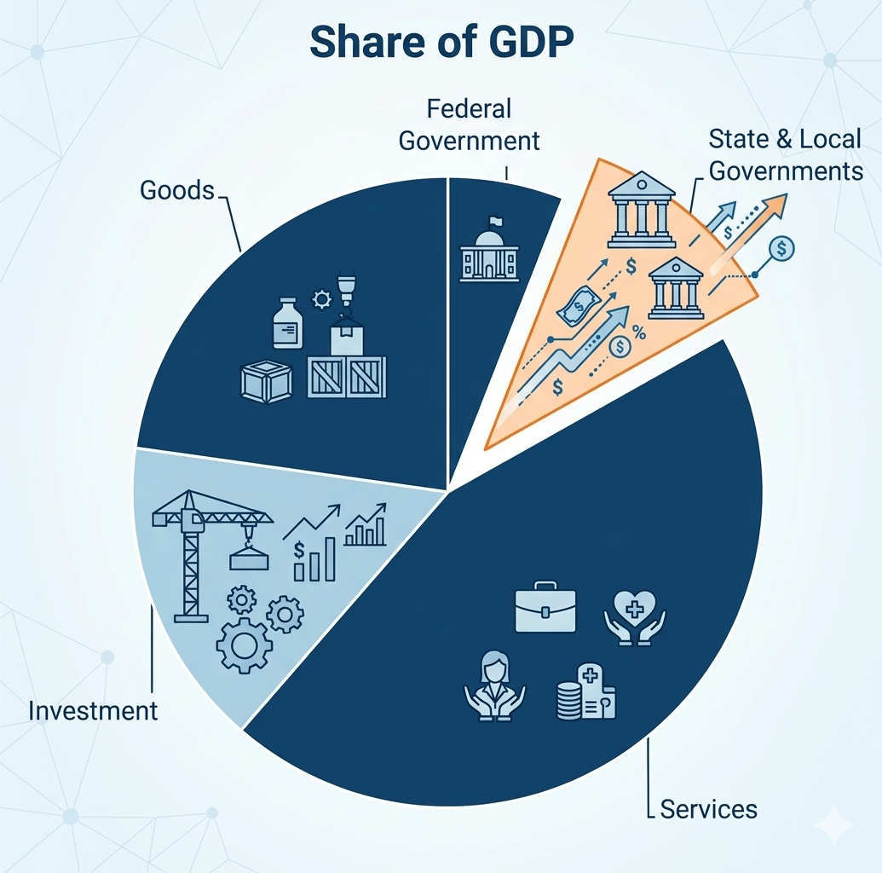
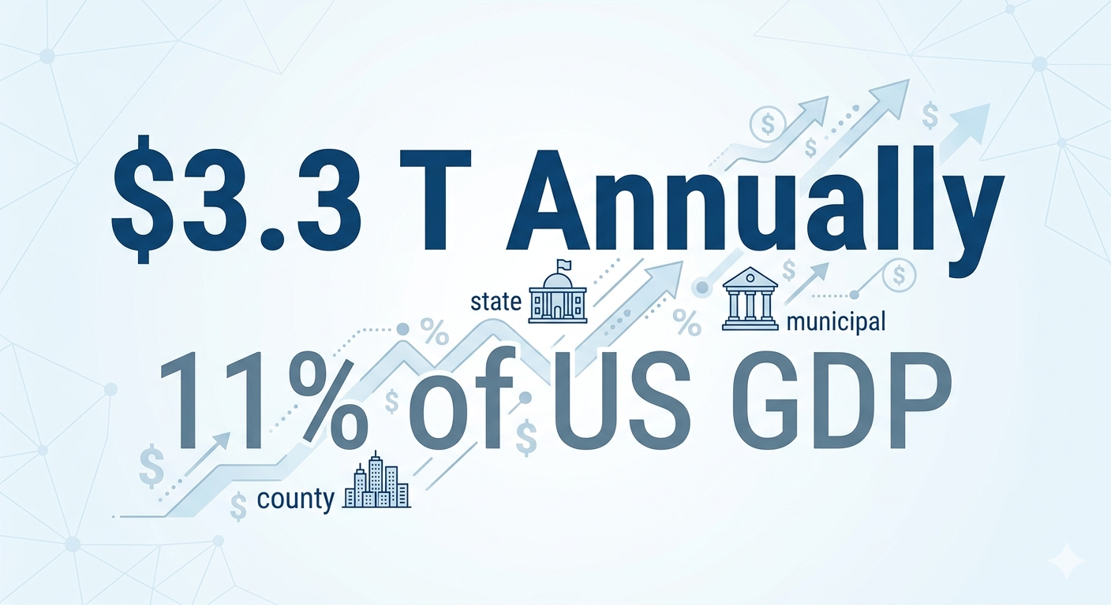

Notes:
USGDP is ~$30T
All government: 17.2% (USA GDP Composition 2025: Pie Chart, Sector Breakdown & Economic Analysis | Economic Indicators)
Federal: $1.9T (6%)
SLG = 3.3T (11%)
The point here is to prove that this is a problem worth tackling. The public data that documents 11% of USGDP exists, and in fact doesn't even take a FOIA request to access, but is effectively useless because thousands of data points are locked up in untagged static PDFs with inconsistent terminology and no consolidation. This is a pretty significant $ value freedom of information problem that gets essentially zero press. Our thinking is, if information is technically available but if you can't use it, can you really call it free?

Slide 3

Notes:
This is a way to think about it. If this was the ACFR data, the warehouse would be unlocked. Anyone could walk in. That's not the way this data is locked up. The data is locked up in its inherent lack of utility as published by every local, county, and state government. Let's jump into some numbers.

Slide 4
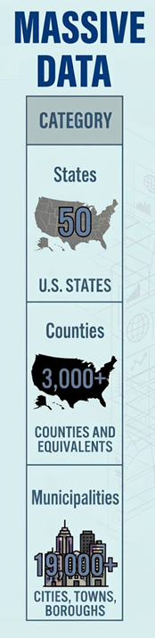
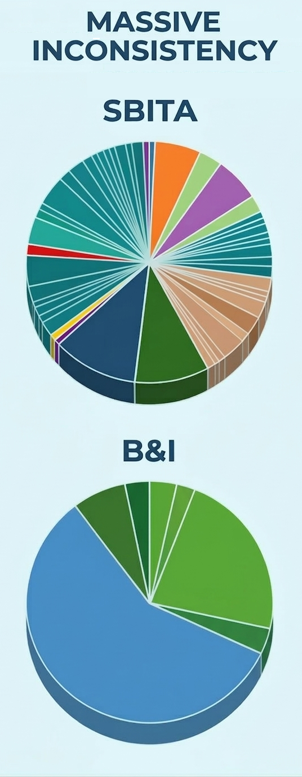
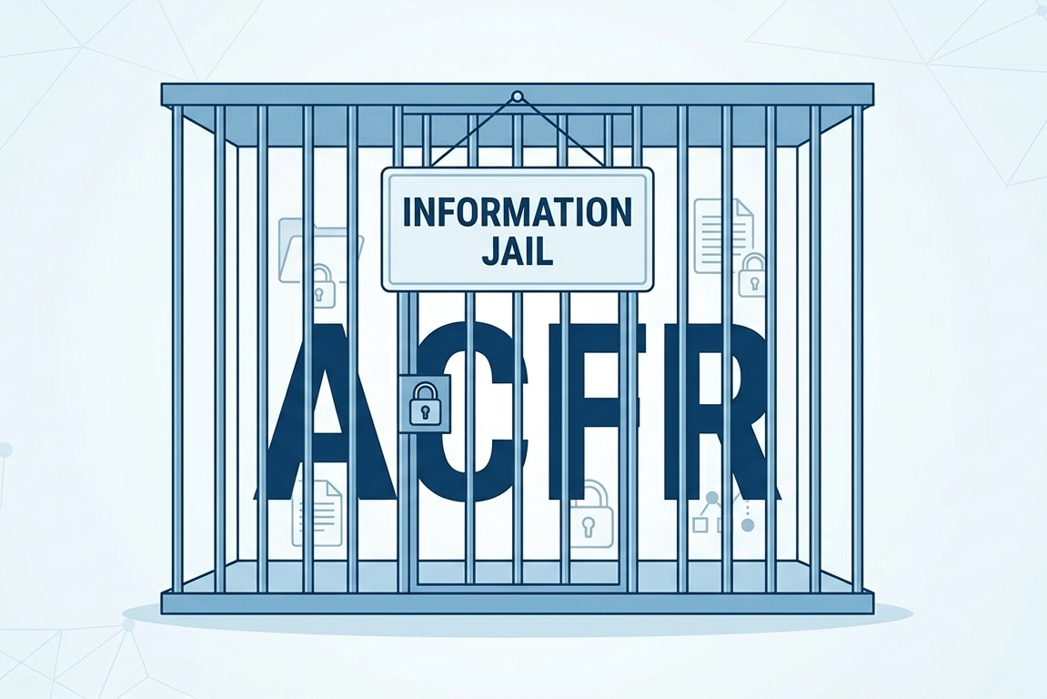
Notes:
There are 90.888 total government entities in the US (USAFacts). Many of them are required by law to produce an annual consolidated financial report. At a minimum that adds up like the first column, with around 25,000 local, county, and state government reports. Each 200 to 500 pages long. Each with at least a thousand pieces of financial data. Every year. And for the past 20 or so years. That's around 100 million pages of data, with easily 100 billion data points. All of which is in static PDFs and nowhere else except the tens of thousands of spreadsheets on which it originated across the country.
But wait, there's more. The contents of an ACFR are defined by GASB. That may sound reassuring at first, but the fact that a standard exists is only comforting on the surface. In the middle of the chart are two very representative illustrations of the variety of reporting for just two of those thousand data points. The upper item, an IT category, had over 170 variants in a subset of three states worth of analyzed ACFRs. The lower item, buildings and improvements "only" had 24 variants.
What does that all add up to? All the public data related to $3.3 trillion in taxpayer spending by state and local governments, is superficially available but effectively in ACFR Jail.

Slide 5

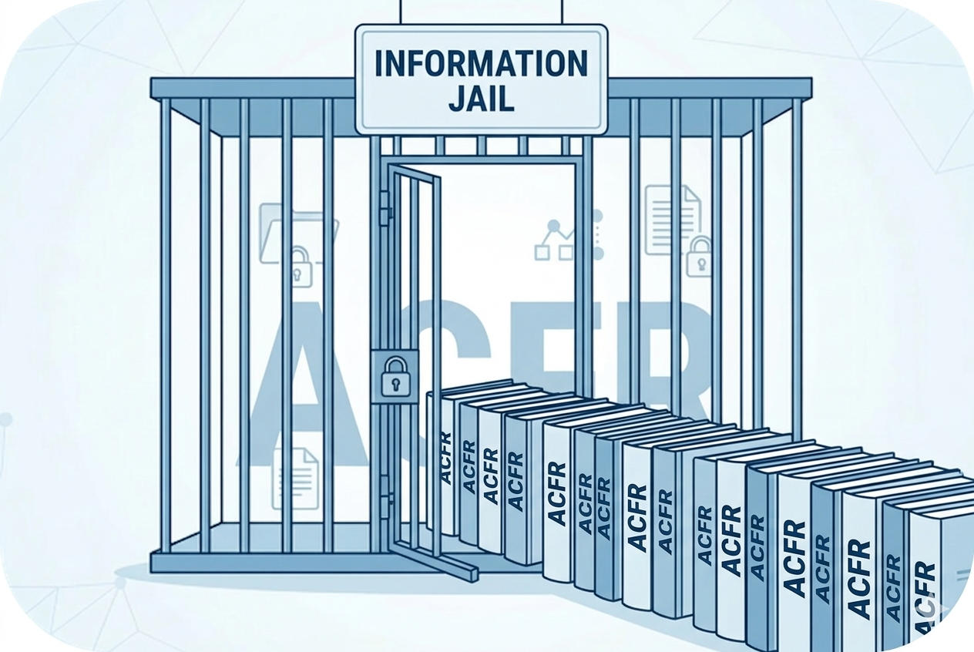
Notes:
So what are we doing about it? We created Project Magilla.
There is a little used English word megillah with an interesting etymology from Yiddish where it meant any long, tedious, or unnecessarily drawn out story. To us, that's a fair representation of an ACFR today. There was also a children's cartoon in the middle 60s called the Magilla Gorilla show. Magilla was good natured, but a perpetual troublemaker and drain on his owner. That's maybe a little cynical, but you can find a lot of tax payers that feel that way about some level of their state, county, or local government. The show always ended with the mantra "We'll try again next week", which to us had huge parallels to the grit and persistence it will take to break the ACFRs out of jail and into the light, so they are both available and usable in a meaningful way.
When we open that door we:
Facilitate public data storytelling at both the individual government atomic unit and for inter-governmental analysis by eliminating the barrier of gathering the data and extracting data points
Enable a freemium model from no-fee access for individuals/appropriate organizations to for-fee services to larger user communities
We can add value to the data beyond just liberating it to create meaningful derivative works
We can create partnerships – profit and non-profit motivated – surrounding the use of this data (folks like the Reason Foundation, one or two state governments themselves, Strong Towns, and other groups have made some inroads here, but no one we have yet found is trying to pull it all together).
Have an opportunity to reflect light on other freedom of information projects
Sets a precedent for other, similar data aggregation programs to run through Tyche

Slide 6
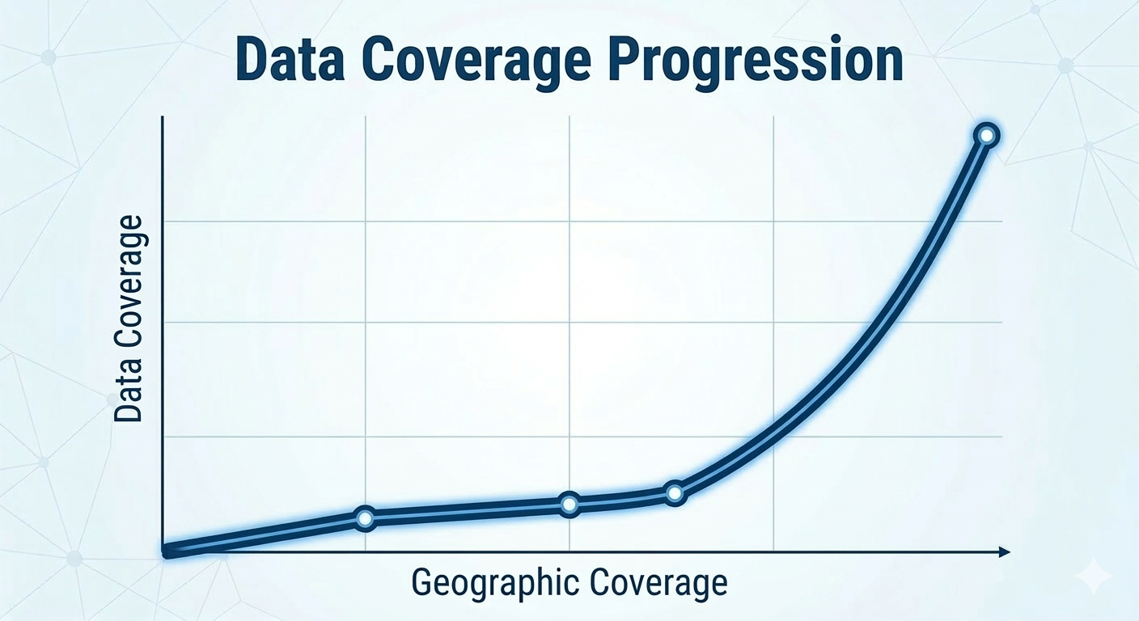
Notes:
Currently we are building out our plan to get to meaningful scale. That is measured by geographic coverage and data coverage. We have proven the ability to extract important subsets of data from moderate sized subsets of ACFRs. For example, to support StrongTowns Financial Decoders at mass scale across multiple states at once. We’ve done a podcast with, and thoroughly enjoy working with. the StongTowns folks.
We are now experimenting with the most effective means of:
Finding all the ACFRs
Dealing with their significant differences
Assuring quality in the extraction
Tagging and proving a transition path to XBRL or iXBRL
Learning, learning, learning
We are looking for kindred spirits. Anything from following us on LinkedIn and Facebook so we can know our community to asking for us to support you in writing a data story about your

Slide 7









Can we help you tell a story? Let’s find out…
With decades at the intersection of data and business for diverse industries, I have expertise in all manner of public data from all levels of government. I am energized about the potential for Tyche to use that knowledge for good.
linkedin.com/company/tycheinsights/
karl@tycheinsights.com
https://calendly.com/karl-tycheinsights
x.com/tycheinsights
reddit.com/user/tycheinsights/
I am a human and technology optimist who hopes people of arbitrarily different opinions can use Tyche to revive information trust via constructive, calm, and competent civic discourse.
facebook.com/profile.php?id=61579646650055
mastodon.social/@TycheInsights
keith@tycheinsights.com
https://calendly.com/keith-tycheinsights

