Slide 1
Sunshine Fest March 2026

Slide 2

Symon Shim
Director, Product Management

Slide 3


Helping teams organize complex data, uncover what matters most, and act with confidence - all in one trusted, extensible, AI-powered platform
20+
Years as a software leader
Since 2003, from e-discovery to data review and analysis solutions.
Data intelligence platform
Manage all data types (docs, mobile, audio, video)
in one place
Government-grade security & compliance FedRAMP Moderate authorized & hosted in Microsoft Azure Government Cloud
Cloud-native scale without infrastructure overhead
Always up to date, no hardware to manage
$150M+
Annual R&D investment
800+ engineers driving research and development for you.
290+
Government agencies
Already using Relativity for high-stakes public-sector work.

Slide 4
More cases. More complexity. end-to-end workflow to help.
What agencies are up against
Our Approach
Fragmented handoffs
across the case lifecycle from intake, review, referral, release, and reporting.
Deadlines & Growing Backlog
of high complexity cases.
Re-work
for similar cases and/or the same records.
Limited visibility
into workload, deadlines, and defensibility.
Seamless workflow from request intake to public disclosure
Intake and Case Management
Review and Redaction
Disclosure Management and Reading Room
Enhance the capabilities of agencies and the public
with purpose-fit, AI-assisted workflows, and intuitive Reading Room experiences
Institutional disclosure history
that learns from prior cases, releases, and exemptions to accelerate defensible responses.
Real-time visibility and automated reporting
for deadlines, backlog, program performance, and quarterly/yearly reporting

Slide 5
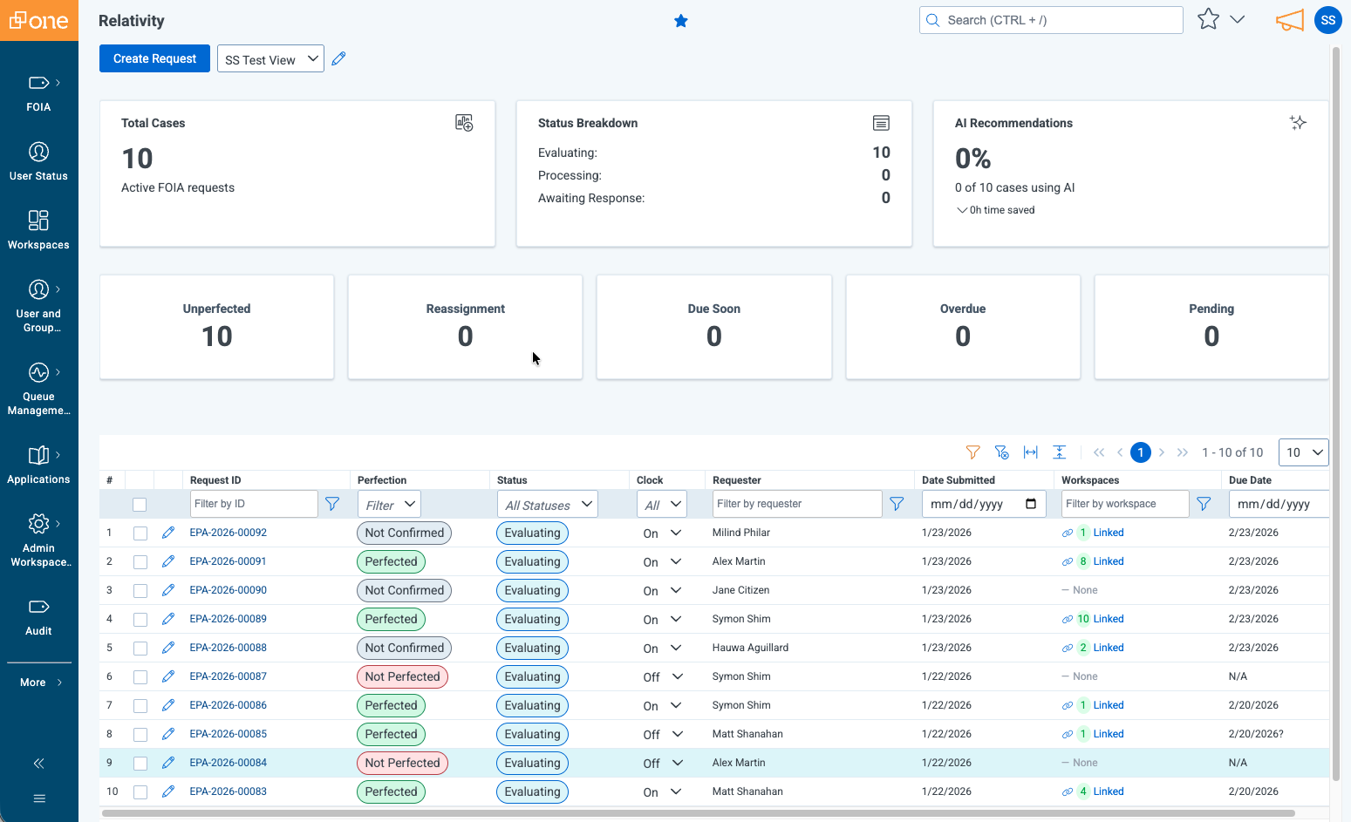
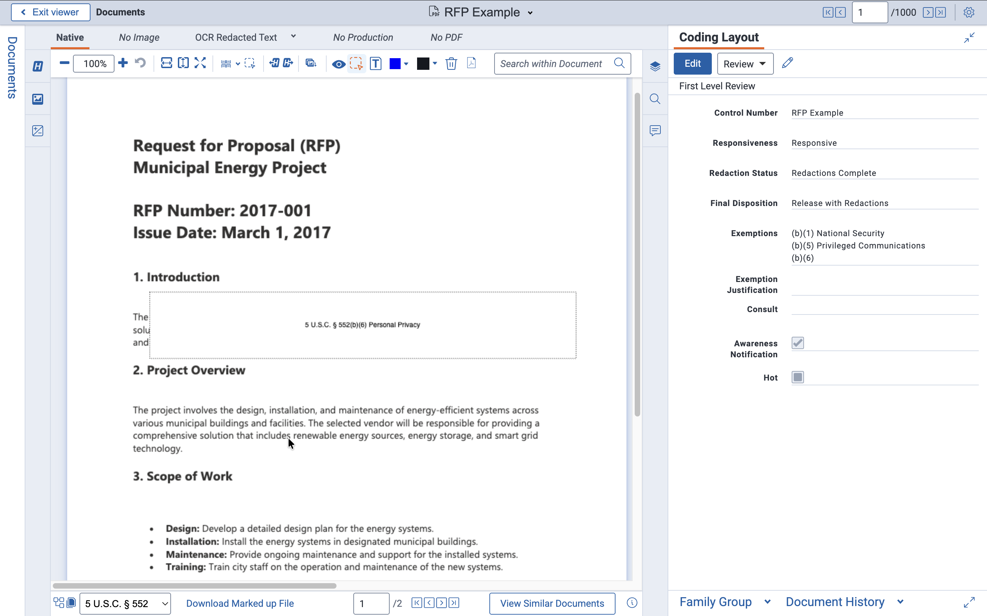
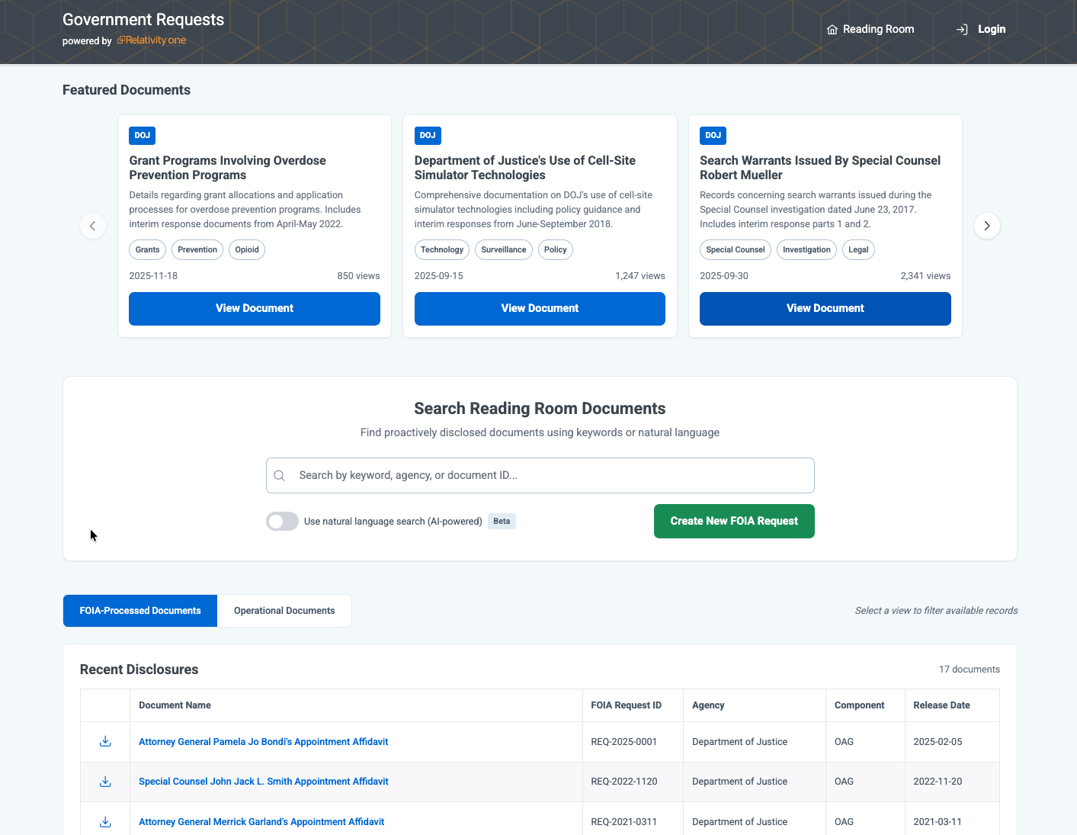



End-to-end? Seamless? Believe it
Intake and Case
Management
Review and
Redaction
Disclosure Management
and Reading Room
Intuitive and streamlined
Robust and genAI-powered
Transparent and powerful
Automated Yearly Reporting
Comprehensive Auditability
Built to Scale (Simple to Complex)
Secure Communication
Notes:
Slide talk track:
Customers have already been using RelOne / RelOne Gov for processing their FOIA cases – we see hundreds of new FOIA and Public Records Access workspaces created every month
We are extending the platform to enable FOIA and Public Records teams to augment what the platform already does with an Intake Portal, Case Management, Reading Room, and Reporting capabilities
Incorporating all the nuances of “managing the clock”, key configurability, while also building for AI-empowerment, cloud scale, and Section 508/accessibility
Advanced Access in Feb to validate with a small cohort, then GA in May
PM(s) to reach out to regarding content on this slide
Symon Shim
Justin Simpson
Brian Thompson

Slide 6
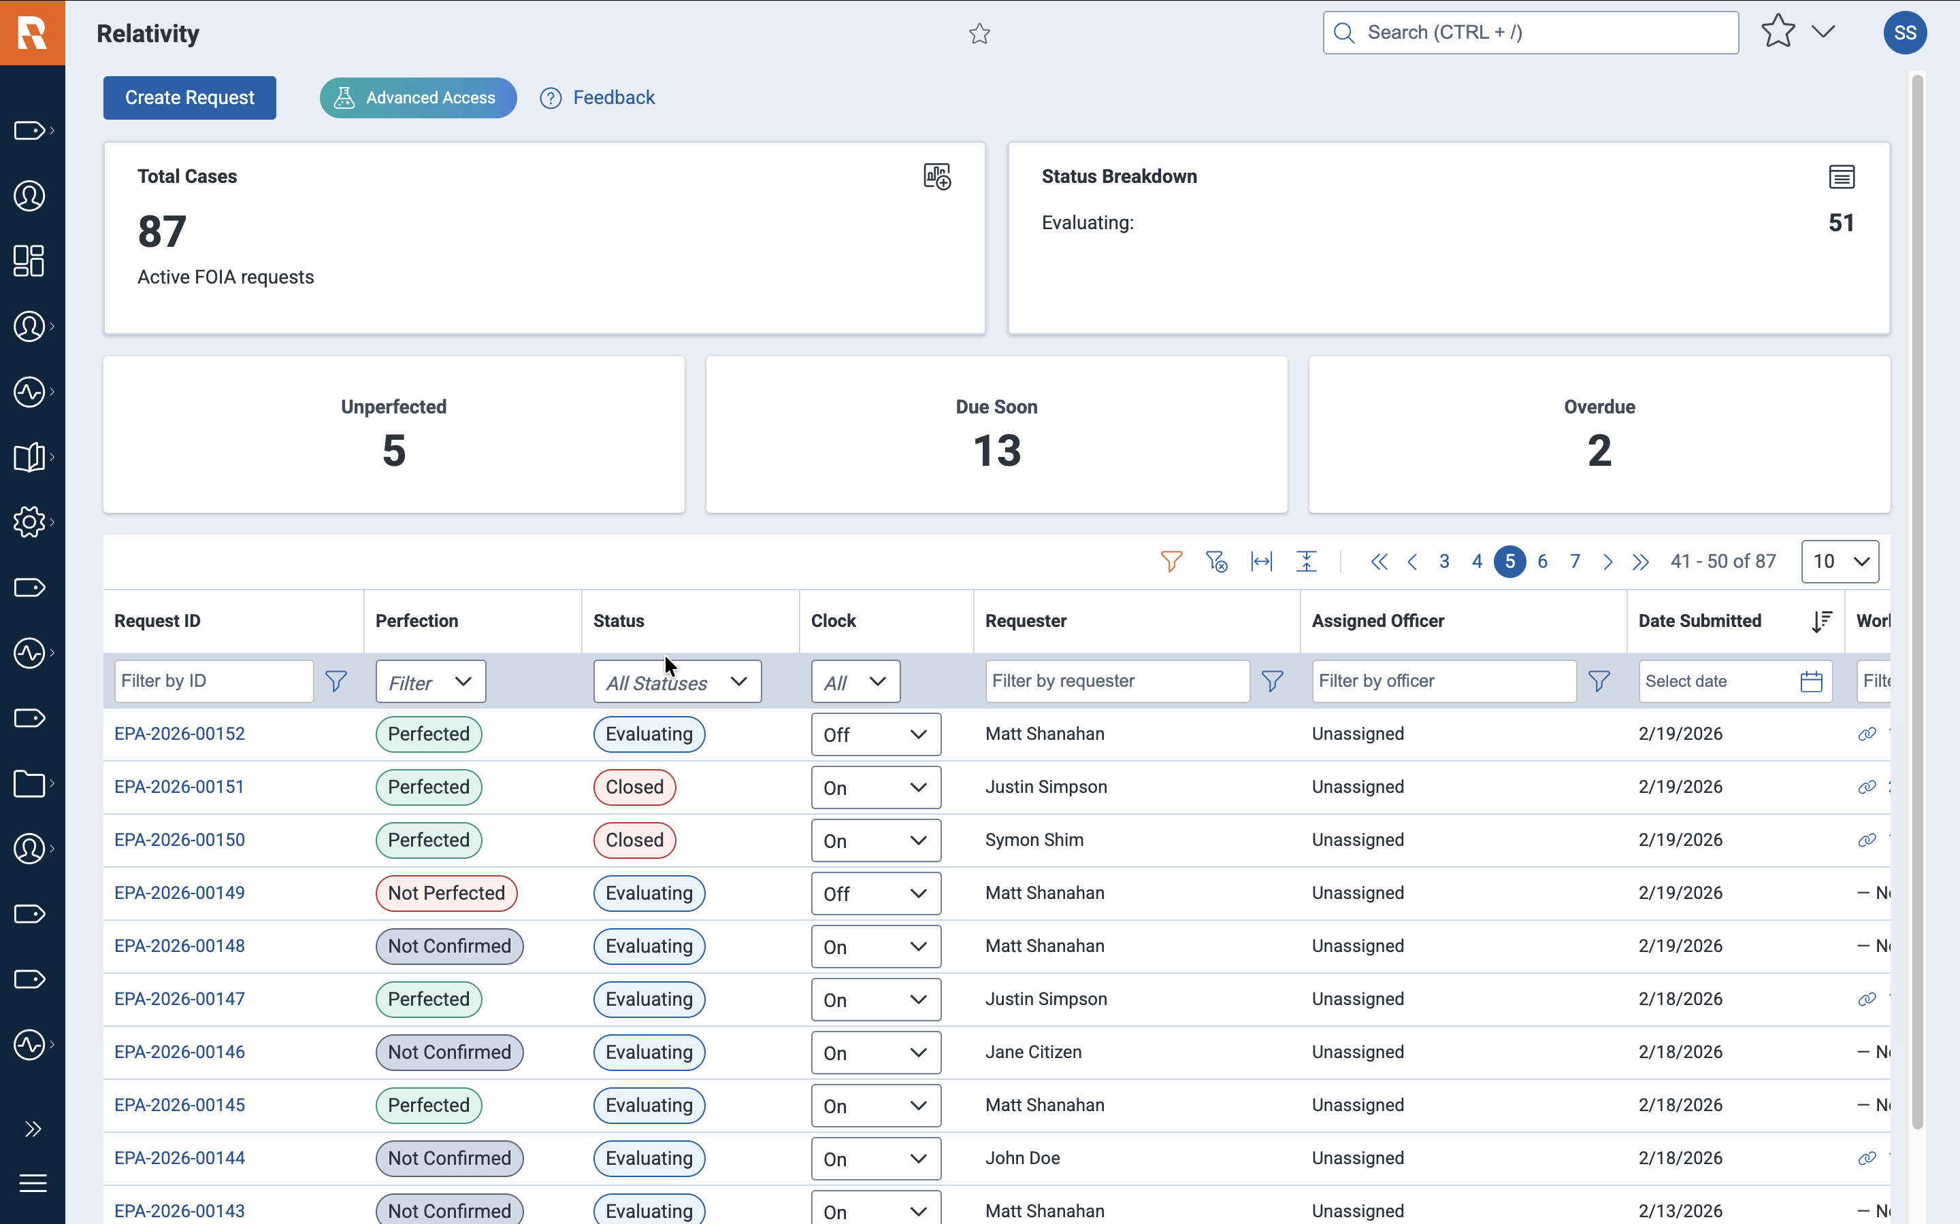
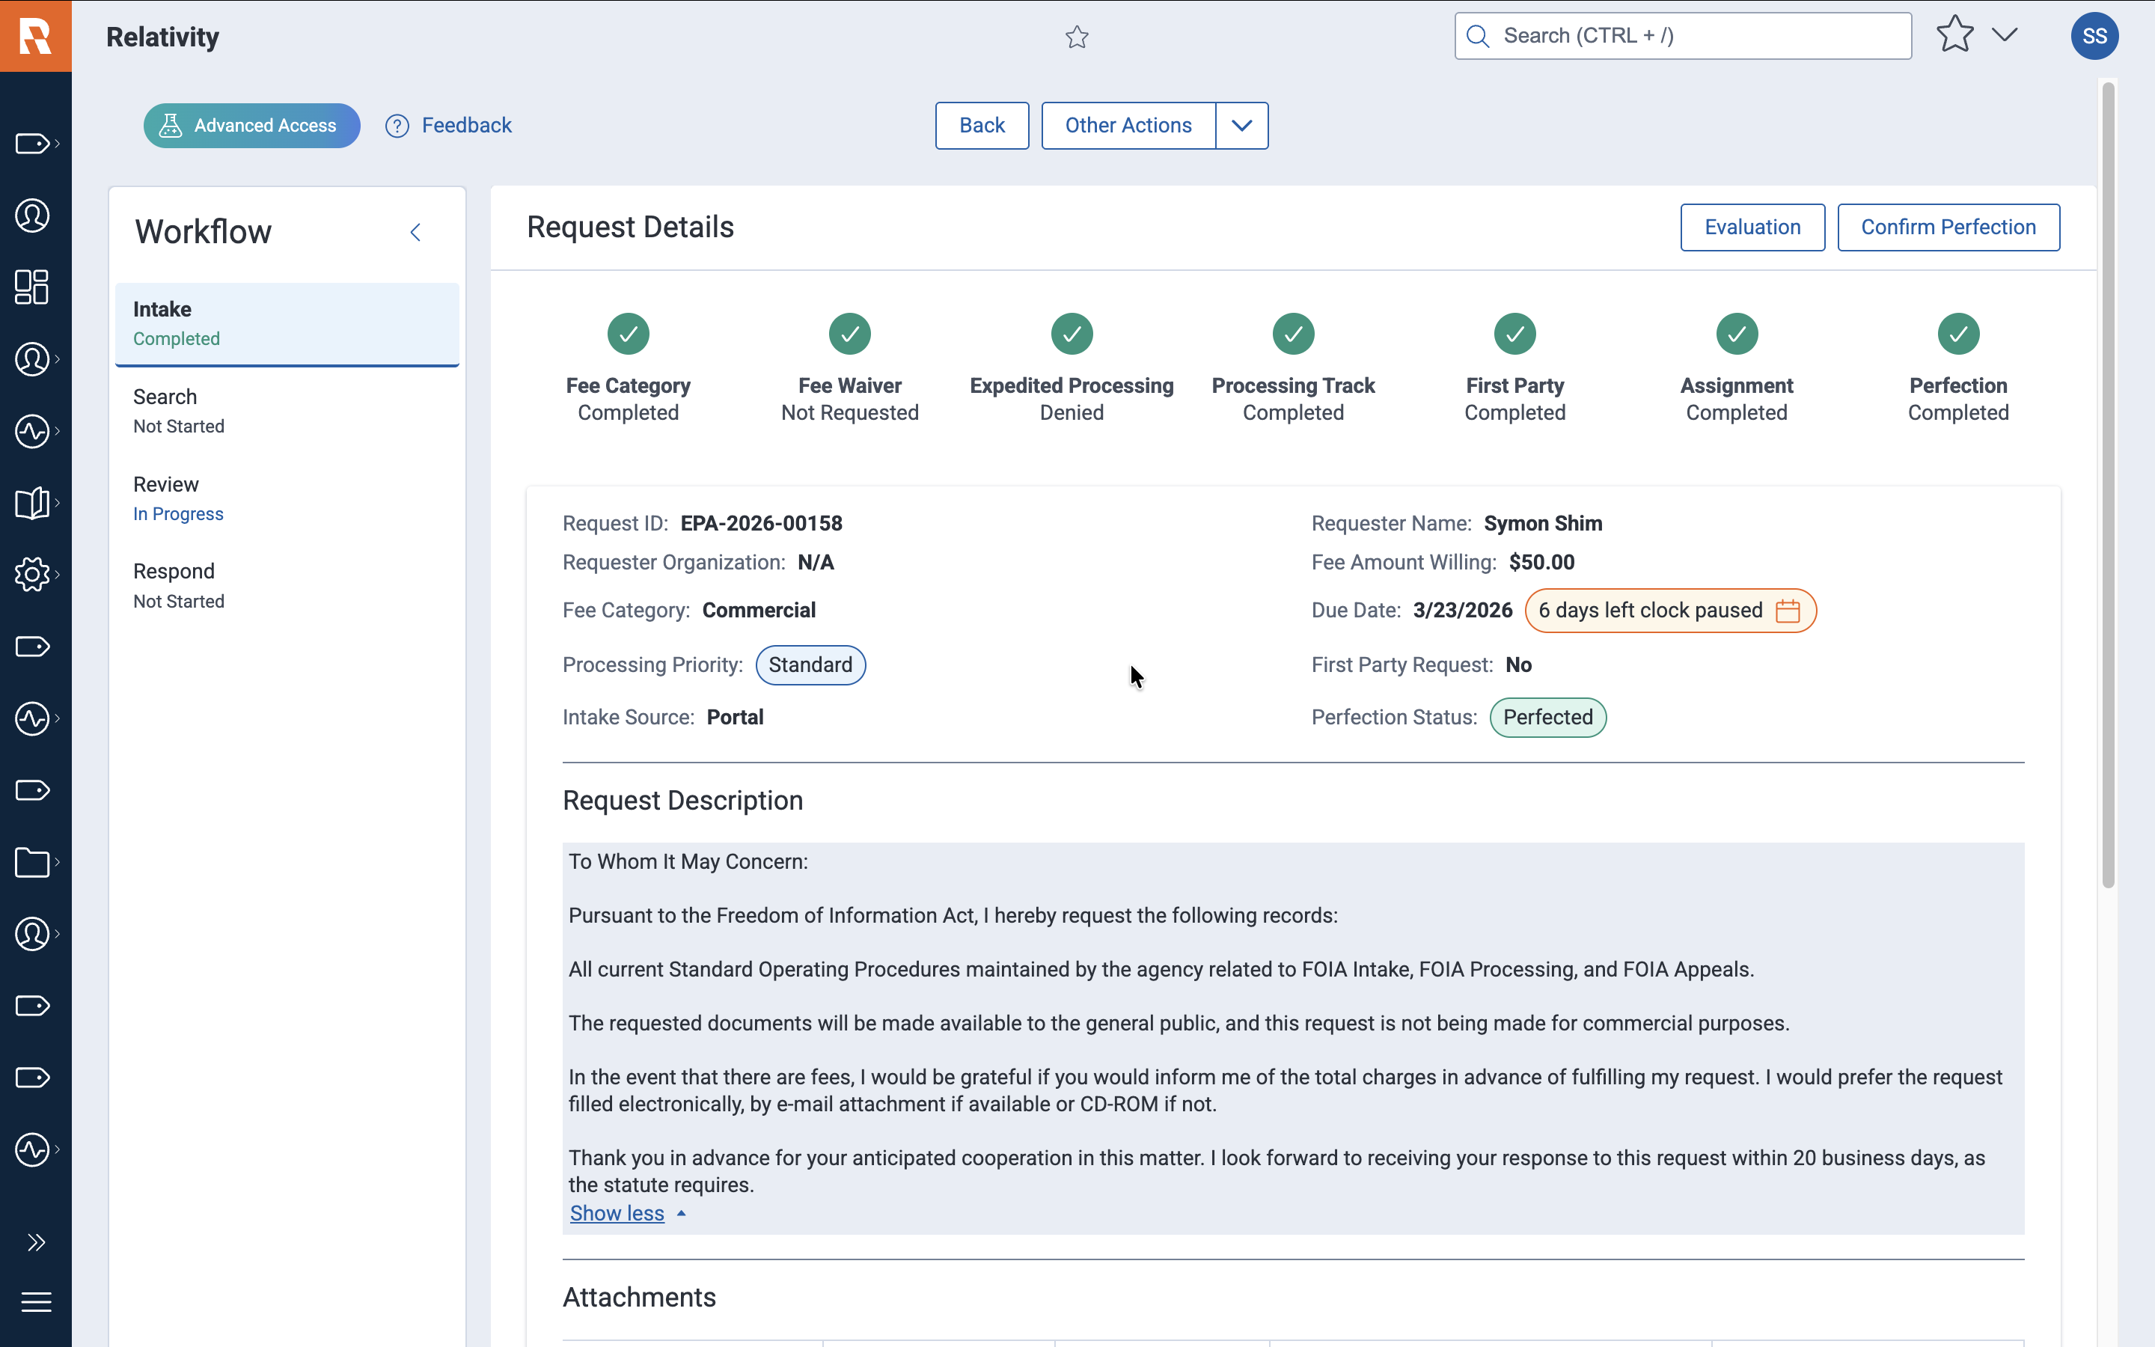
Reduce the backlog. Beat the clock
Speed with consistency See the full backlog and due dates in one view. Move requests through review with a consistent workflow. Capture a defensible trail of every action and decision. Standardize requester communications. Manage tasks, referrals, and consultations in one flow.
See the case progress
More visibility into where a request stands.

Slide 7
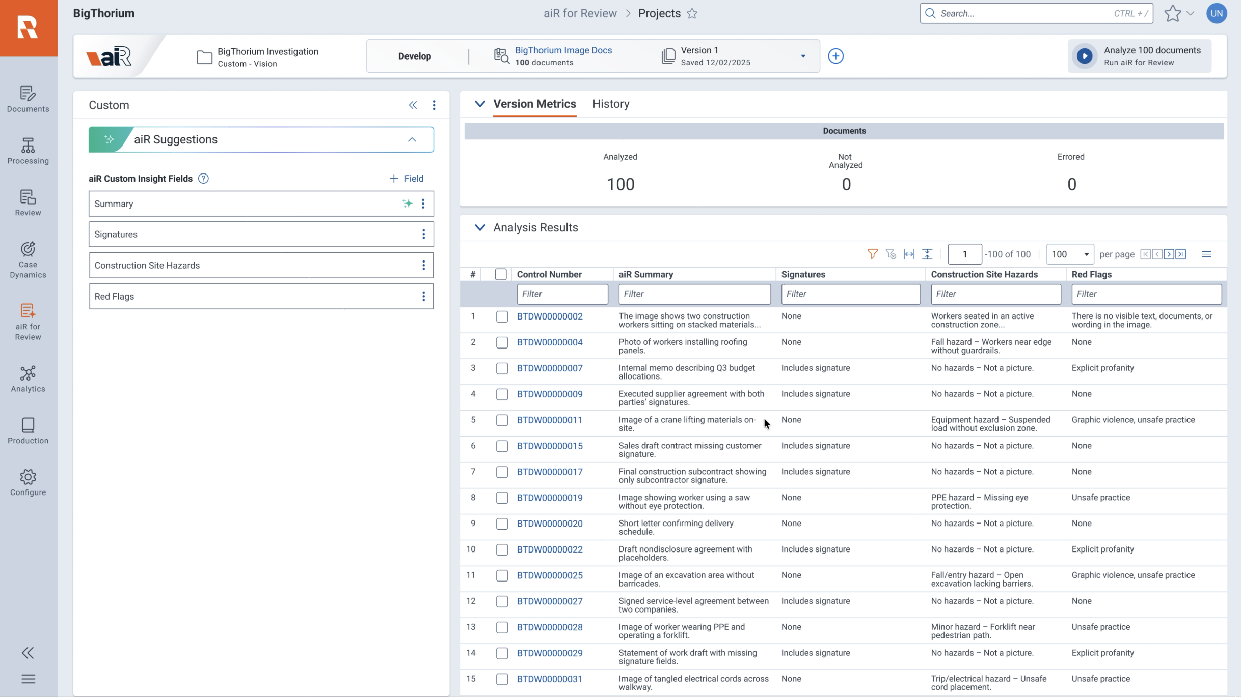
Review. Faster, smarter
AI Your Way Customize AI with agency standards to find responsive records and predict PII/CBI and other exemptions faster. Move faster on interim and final responses with more consistent determinations. Respond to complex and high- volume requests with high confidence in less time.
Response, received
Increased consistency and useful disclosures
Notes:
“Instead of forcing FOIA teams into a one-size-fits-all model, we let them define the analyses that matter to their records — from responsiveness to PII, CBI, and exemption review — and get structured, reviewable outputs back. That helps teams move faster while keeping human judgment in control.”

Slide 8
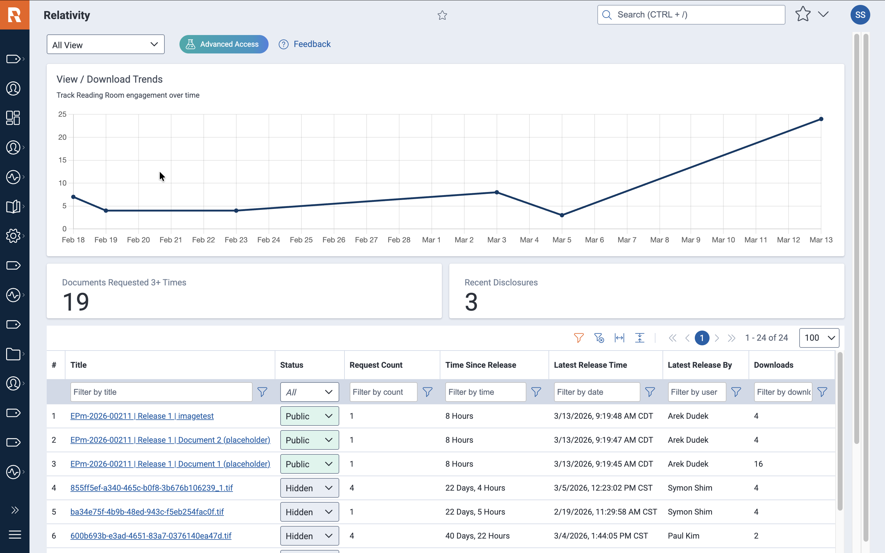
Publish once. Search instantly
Your Time Matters Identify documents requested 3+ times without manual reposting. Push approved releases to the Reading Room in milliseconds. Hide or restore content instantly with full audit history. Evaluate the public’s engagement with documents in the Reading Room.
Find it. Easily.
Search approved releases fast and intuitively.
Notes:
Relationship between the FOIA team and the public
- FOIA team: Find documents that meet the "rule of 3" - FOIA team: for documents that meet this or are part of a general release to Reading Room, have that occur in MILLISECONDS (no more manual copying of data) - FOIA team: hiding is just as simple, click of a button - FOIA team: INSPECT the audit trail of how documents have been released over time - FOIA team: See how the public is engaging with the content you are putting up in the Reading - Public: search across these documents - Public: know that the documents that are up are intentional not just slapdash potpourri of stuff - Public: know that your engagement matters (because the FOIA team can actually see it)

Slide 9
Questions?

Slide 11
Who Is Relativity?
Our Mission
Organize data. Discover the truth. Act on it.
Government work is high-stakes. Relativity partners with agencies to deliver reliable technology, proven expertise, and mission-aligned support—so your team can act quickly, accurately, and with full transparency.
End-to-end legal data intelligence platform: manage all data types (documents, mobile, audio, video) in one place.
FedRAMP authorized & hosted in Microsoft Azure Government Cloud: maximum security and compliance.
AI-powered insights: accelerate review and improve decision-making.
Cloud-native scalability & zero infrastructure burden: always up to date, no hardware to manage.
Enhanced collaboration: one secure platform for teams and agencies.
Predictable costs & operational efficiency: free up resources to focus on strategy, zero infrastructure burden
Expert support for government workflows: tailored guidance and best practices.
Founded in 2003
Started as modern e-discovery platform and has evolved into a full legal data intelligence solution
Innovation Leadership
$150M+ annual R&D investment; 800+ engineers driving research and development
Public Sector Expertise
Trusted by major federal agencies and leading state and local governments
Community and Ecosystem
Largest network of certified partners, practitioners, and solution providers in legal tech
Notes:
But first, who is Relativity…
Our Mission
We were founded in 2003 as a pioneer in developing a modern approach to e-Discovery pairing a scalable, web-based platform with advanced analytics long before it became the industry standard, since then we’ve grown beyond just eDiscovery into other areas of legal data intelligence, we’ve been through multiple evolutions and major transformations through the years and continue to evolve as we invest over $150M in R&D each year and have over 800 engineers focused on ensuring our platform continues to evolve and develop with the latest technology/advancements
We have public sector expertise and have been serving public sector for over 15 years
We’ve also got one of the largest network of certified partners and professionals in legal tech

Slide 12
Relativity provides an all-in-one, end-to-end solution for FOIA
Intake
Search, Review
Respond
Intuitive Evaluation
aiR – AI-powered responsiveness
Seamless, AI-powered
Disclosure Center
FOIA Solution

Slide 13
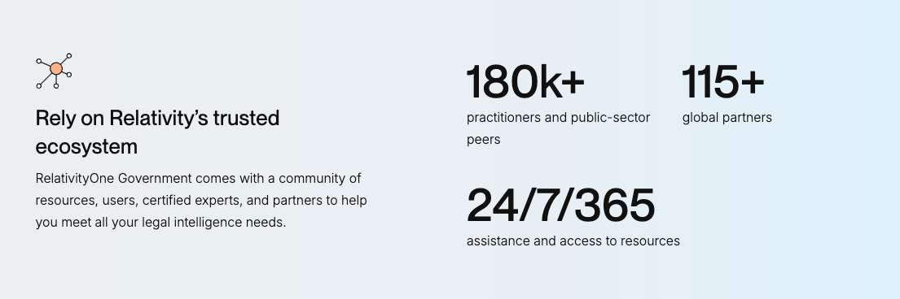
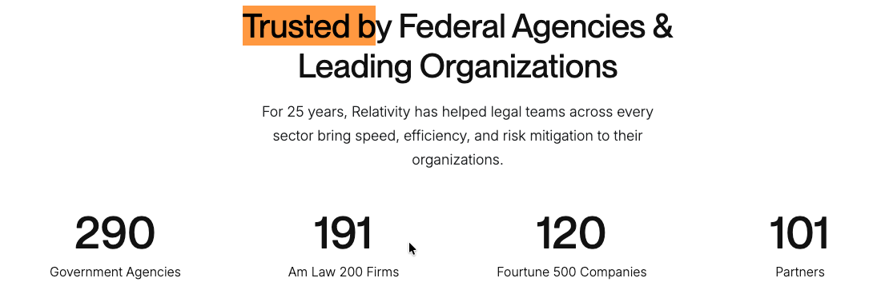
Who Is Relativity?
Relativity helps legal teams organize complex data, uncover what matters most, and act with confidence – all in one trusted, extensible, AI-powered platform.
FedRAMP authorized & hosted in Microsoft Azure Government Cloud:
maximum security and compliance that we call RelativityOne Government
290
Government Agencies
180K+
Practiotiners and public-sector peers
191
AmLaw 200 Firms
Notes:
But first, who is Relativity…
Our Mission
We were founded in 2003 as a pioneer in developing a modern approach to e-Discovery pairing a scalable, web-based platform with advanced analytics long before it became the industry standard, since then we’ve grown beyond just eDiscovery into other areas of legal data intelligence, we’ve been through multiple evolutions and major transformations through the years and continue to evolve as we invest over $150M in R&D each year and have over 800 engineers focused on ensuring our platform continues to evolve and develop with the latest technology/advancements
We have public sector expertise and have been serving public sector for over 15 years
We’ve also got one of the largest network of certified partners and professionals in legal tech

Slide 14
Transform FOIA & PRA processing with an AI-powered, end-to-end platform from case submission to defensible disclosure - powered by RelativityOne Government.
What agencies are up against
Our Approach
Fragmented handoffs across the case lifecycle from intake, review, referral, release, and reporting.
Statutory deadlines and growing backlog of high complexity cases.
Re-work for similar cases and/or the same records.
Limited visibility into workload, deadlines, and defensibility.
One, seamless workflow from request intake to public disclosure
Enhance the capabilities of agencies and the public with purpose-fit workflows and AI
Institutional disclosure history that learns from prior cases, releases, and exemptions.
Real-time visibility into deadlines, backlog, and program performance
DIFFERENTIATORS
Notes:
Slide talk track:
Customers have already been using RelOne / RelOne Gov for processing their FOIA cases – we see hundreds of new FOIA and Public Records Access workspaces created every month
We are extending the platform to enable FOIA and Public Records teams to augment what the platform already does with an Intake Portal, Case Management, Reading Room, and Reporting capabilities
Incorporating all the nuances of “managing the clock”, key configurability, while also building for AI-empowerment, cloud scale, and Section 508/accessibility
Advanced Access in Feb to validate with a small cohort, then GA in May
PM(s) to reach out to regarding content on this slide
Symon Shim
Justin Simpson
Brian Thompson

Slide 15
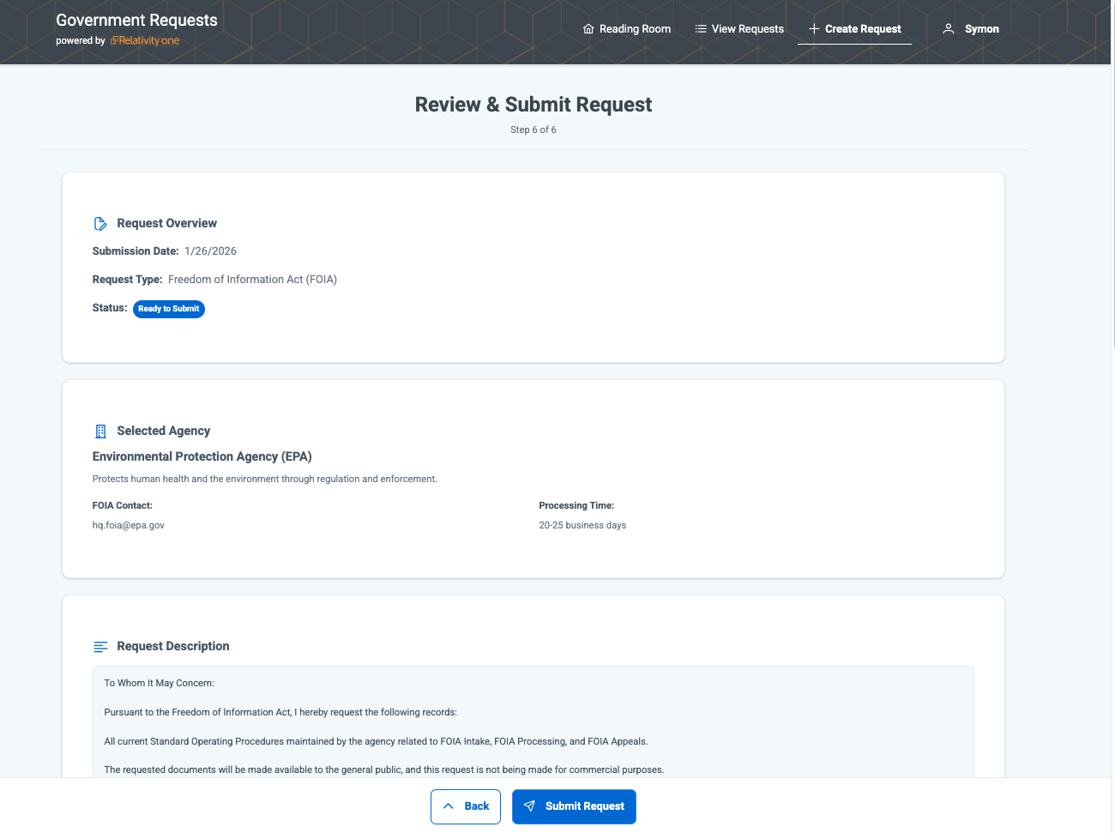
An end-to-end, seamless solution for FOIA workflows
Intuitive and streamlined
Intake and Case Management
Robust and genAI-powered
Review and Redaction
Transparent and powerful
Disclosure Management and Reading Room
Including Automated Yearly Reporting, Comprehensive Auditability, Communication, and Built to scale to handle the simplest FOIA case to the most complex litigation
Notes:
Slide talk track:
Customers have already been using RelOne / RelOne Gov for processing their FOIA cases – we see hundreds of new FOIA and Public Records Access workspaces created every month
We are extending the platform to enable FOIA and Public Records teams to augment what the platform already does with an Intake Portal, Case Management, Reading Room, and Reporting capabilities
Incorporating all the nuances of “managing the clock”, key configurability, while also building for AI-empowerment, cloud scale, and Section 508/accessibility
Advanced Access in Feb to validate with a small cohort, then GA in May
PM(s) to reach out to regarding content on this slide
Symon Shim
Justin Simpson
Brian Thompson

Slide 16
Reduce the backlog and beat the clock
Speed with consistency See the full backlog and due dates in one view. Move requests through review with a consistent workflow. Capture a defensible trail of every action and decision. Standardize requester communications. Manage tasks, referrals, and consultations in one flow. See the case progress More visibility into where a request stands.

Slide 17
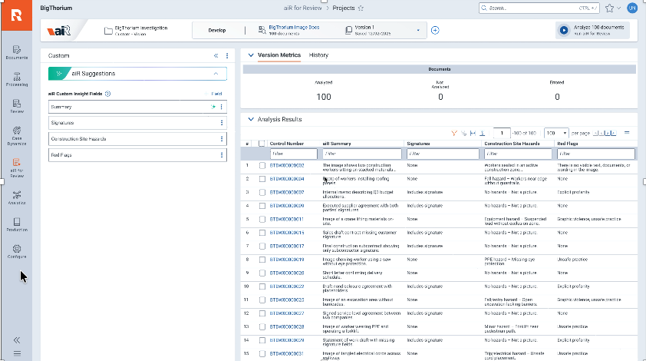
Find responsive records and exemptions faster and smarter
AI Your Way Customize AI with agency standards to find responsive records and predict PII/CBI and other exemptions faster. Move faster on interim and final responses with more consistent determinations. Respond to complex and high- volume requests with high confidence in less time. Response, received Increased consistency and useful disclosures.
Notes:
“Instead of forcing FOIA teams into a one-size-fits-all model, we let them define the analyses that matter to their records — from responsiveness to PII, CBI, and exemption review — and get structured, reviewable outputs back. That helps teams move faster while keeping human judgment in control.”

Slide 18
Publish once. Search instantly
Your time matters. Identify documents requested 3+ times without manual reposting. Push approved releases to the Reading Room in milliseconds. Hide or restore content instantly with full audit history. Evaluate the public’s engagement with documents in the Reading Room. Find it. Easily. Search approved releases fast and intuitively.
Notes:
Relationship between the FOIA team and the public
- FOIA team: Find documents that meet the "rule of 3" - FOIA team: for documents that meet this or are part of a general release to Reading Room, have that occur in MILLISECONDS (no more manual copying of data) - FOIA team: hiding is just as simple, click of a button - FOIA team: INSPECT the audit trail of how documents have been released over time - FOIA team: See how the public is engaging with the content you are putting up in the Reading - Public: search across these documents - Public: know that the documents that are up are intentional not just slapdash potpourri of stuff - Public: know that your engagement matters (because the FOIA team can actually see it)

Slide 19
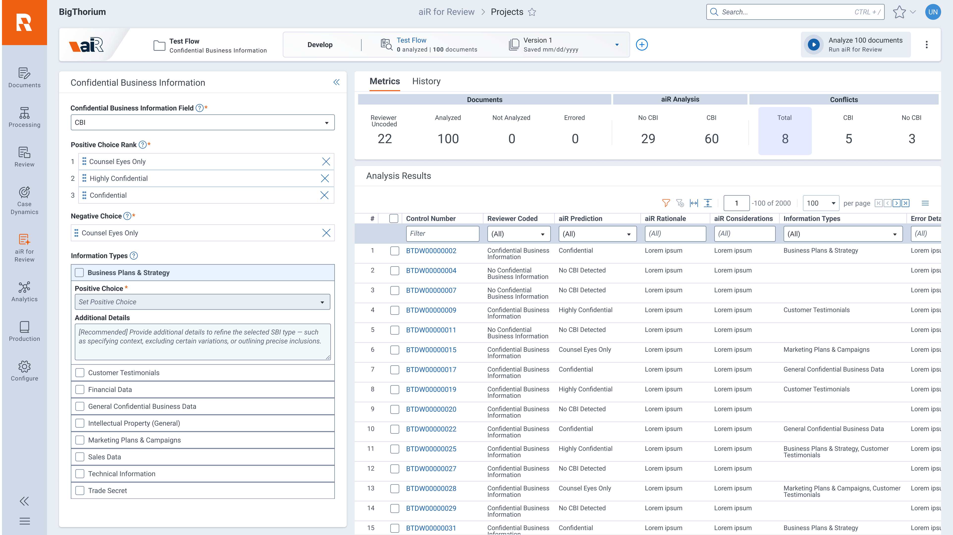
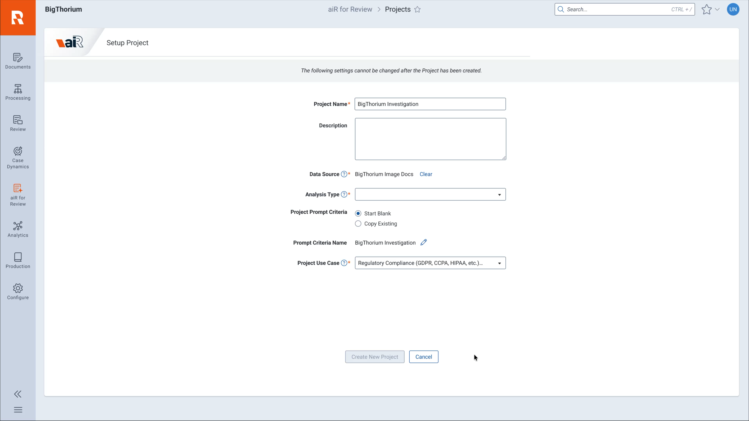
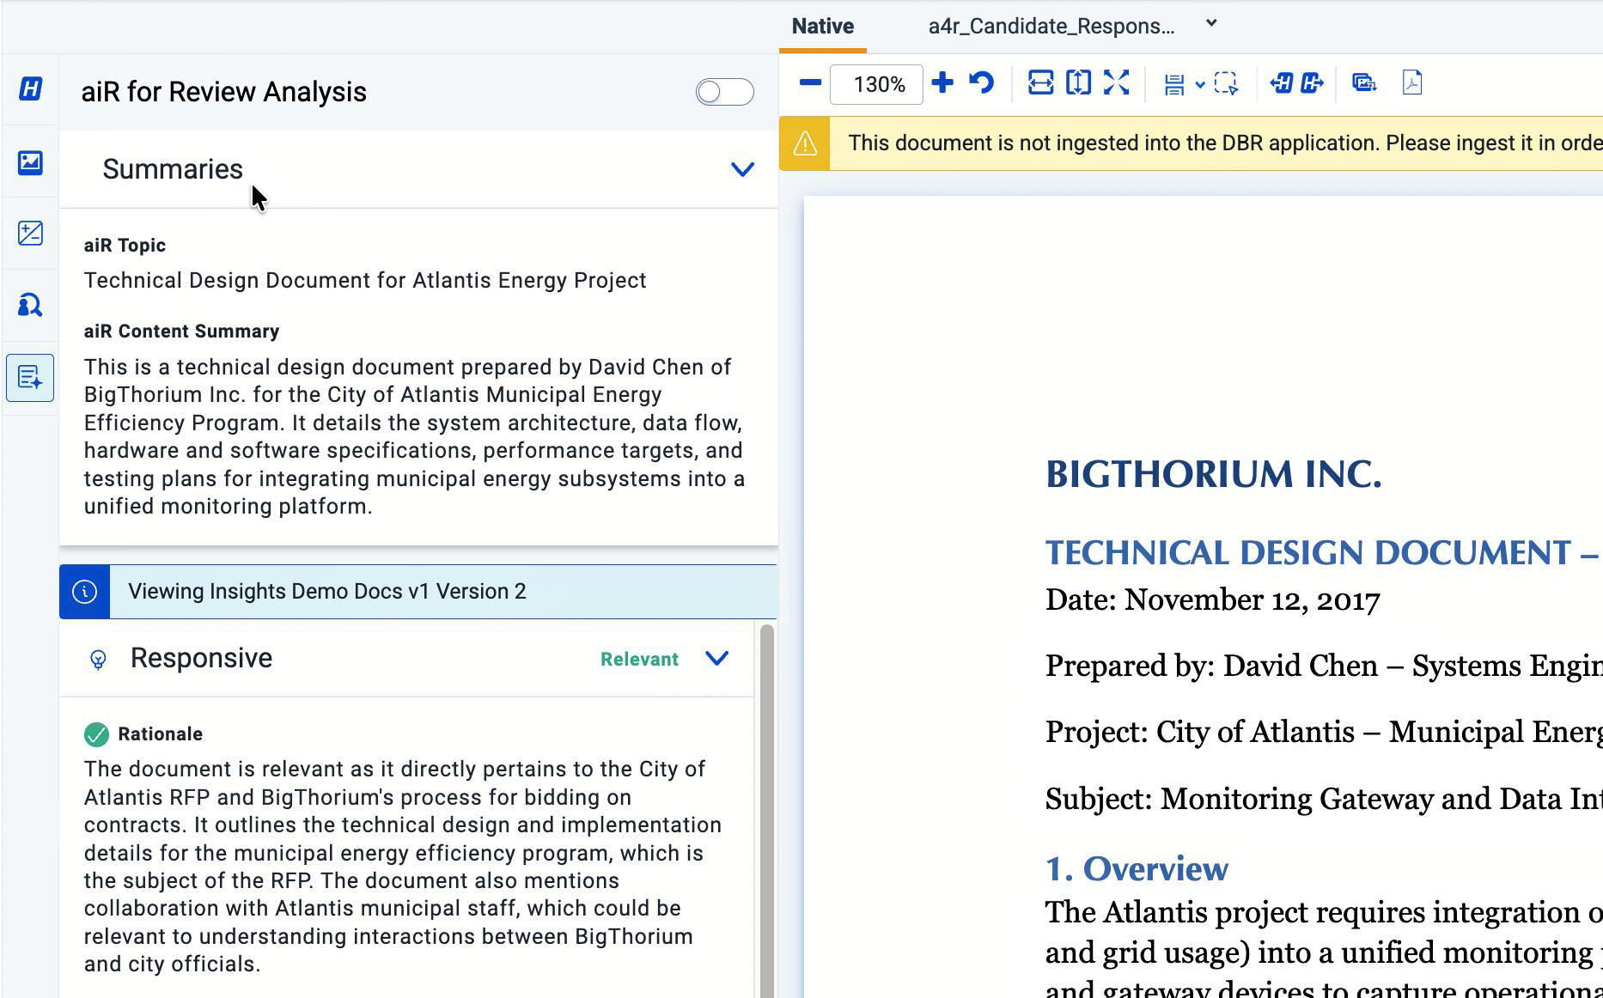
aiR for Review Available in RelativityOne Commercial and RelativityOne Government now – GLOBALLY
Become a prompting expert, drive more value from each analysis, and scale your aiR workflows
1H 2026: Identify and redact confidential business information and personal information with greater speed and accuracy than traditional methods to protect your data across LDI use cases.
H1 2026: Seamlessly create new insights, extract key content, and perform comprehensive document review for any LDI use case – without writing a single line of code – while leveraging aiR for Review functionality like project sets, iteration workflows, and the validation framework to have confidence in your Gen AI approach.
Full year: We continue to innovate in core workflows, with recent enhancements like Summaries & Topics and additional ease of use enhancements through the rest of 2026.
Notes:
Talk Track
Since becoming generally available in 2024, aiR for Review has continued to scale rapidly—with customers consistently reporting major reductions in cost, improved quality, and dramatically faster time to results. Heading into 2026, we’re building on that momentum by expanding how aiR can help teams understand, protect, and act on their document populations with even greater precision --- across many LDI use cases.
This year, we are introducing 3 new pieces of functionality:
1. Introducing custom analysis in aiR for Review – unleashing the creativity of the Relativity community. We’ve learned a tremendous amount over the last two years about how teams use aiR for Review across relevance, issues, privilege, and more. Now we’re democratizing that power.
Customers will be able to create their own custom LDI-style analyses directly inside aiR for Review – think of it as creating your own relevance review specifically for your type of documents/use cases/snowflakes.
Write your own tailored prompt instructions for any analysis use case
Define what context a user can provide (e.g. case summary)
Specify the structured outputs aiR returns (single choice, long text, rationales, considerations, citations, etc.)
We’ll enable customers to unlock new workflows such as content extraction (e.g. look at all these PDFs and extract the invoice totals and stick it into a Relativity field), bespoke client-specific classifications (e.g. special clients have special classification workflows), or net-new analysis types that Relativity doesn’t yet ship out of the box (e.g. partners can create their own “DSAR analysis”).
All of this is delivered through aiR for Review’s transparent, human‑in‑the‑loop experience—empowering teams and partners to codify their expertise, differentiate their services, and solve matter‑specific challenges with generative AI.
This work is in active discovery with an AA program opening in Q1 and GA scheduled for Q2 2026. We’re actively seeking customers who want to participate in early research and help shape this capability.
When customers speak about other AI tools allowing users to quickly extract data from docs and summarize, this serves as our step one.
2. PII & Confidential Business Information & FOIA – Context‑Aware Confidentiality Review
We are introducing three new generative AI–based Analysis Types that detect Personal Information (PI) and Confidential Business Information (CBI) and FOIA exemptions with far greater precision than traditional pattern‑based methods.
These analysis types leverage context‑aware language models to:
Identify subtle, implied, or poorly OCR’d sensitive content
Reduce false positives from naïve keyword or RegEx‑based approaches
Provide structured outputs including the classification, rationale, considerations, and citations
Support iterative refinement through prompt‑based customization
Out of the box, the models support the most common global PI, CBI, and FOIA categories, with extensibility planned for later iterations. By General Availability in 2026, PI classifications will be paired with automated redactions, allowing teams to immediately act on what the system identifies.
Roadmap:
Q1: Confidential Business Information released to Advanced Access
Q2: Personal Information released to Advanced Access
Q3: FOIA exemptions
3. Insight Layers – Understanding What’s in Your Document Population
We know that review teams need more than classifications—they need immediate understanding of what’s in their corpus. That’s why we released doc summaries and topics
For every aiR for Review job, customers now receive automatic high‑value insights such as:
Content summaries for each document
Content topics for each document
These insights deliver context that accelerates review decisions, reduces risk, and strengthens defensibility—bringing back the intuition and situational awareness that’s often lost in strictly protocol‑driven workflows.
We’ll begin to evaluate areas of RelOne where these type of insights might provide useful for ECI and culling tasks.
FAQ
CAT:
Q: What are custom analysis types? A: They allow customers to write their own prompt‑based analysis instructions, define expected outputs, and create fully customized document analyses—directly inside aiR for Review.
Q: What use cases can I build with this? A: Any LDI‑style document analysis, including content extraction, bespoke client‑specific classifications, new matter‑specific workflows, or net‑new analysis types that Relativity doesn’t yet include out of the box.
Q: Will partners be able to publish analysis types to their clients? A: Yes. We are actively exploring ways for partners to build, package, and distribute analysis types across instances. This will be a key opportunity for them to package their expertise and create differentiated value for their customers.
Q: Can custom analysis work on objects beyond documents? A: The team is evaluating multi‑document and non‑document object support as part of the roadmap.
Q: What will this cost? A: This will roll into standard integrated aiR pricing and aiR Unit Thresholds.
Q: How can I get involved early? A: We’re actively recruiting customers for research sessions. Let me know if you want an introduction to the PM team.
PII/SBI:
Q: What do the new PI/CBI analysis types do? A: They classify documents containing Personal Information and Confidential Business Information using context‑aware large language models—detecting subtle, implied, or poorly OCR’d references that traditional keyword or RegEx approaches miss.
Q: What results will I receive? A: Document‑level classifications (PI/CBI), rationale and considerations, and citations to relevant passages. In 2026, PI classifications will also generate automated redactions.
Q: When will automated redaction be available? A: Automated PI redactions will be delivered at General Availability later in 2026.
Q: What PI/CBI types will you support? A: The most common global PI categories and widely encountered confidential business information types. The catalog will expand over time.
Q: Will I be able to define my own PI/CBI categories? A: Not initially. Extensibility is being evaluated for future releases.
Q: How do I participate in the Advanced Access program? A: We’re looking for customers with pre‑coded PI/CBI datasets. I can connect you with the product team.
PM(s) to reach out to regarding content on this slide
Bryce Lew
Salma Kamni
Elza Hayyat
Maks Babuder
Peter Haller

Slide 20
aiR for Review Available in RelativityOne Commercial and RelativityOne Government now – GLOBALLY
Become a prompting expert, drive more value from each analysis, and scale your aiR workflows
Notes:
Talk Track
Since becoming generally available in 2024, aiR for Review has continued to scale rapidly—with customers consistently reporting major reductions in cost, improved quality, and dramatically faster time to results. Heading into 2026, we’re building on that momentum by expanding how aiR can help teams understand, protect, and act on their document populations with even greater precision --- across many LDI use cases.
This year, we are introducing 3 new pieces of functionality:
1. Introducing custom analysis in aiR for Review – unleashing the creativity of the Relativity community. We’ve learned a tremendous amount over the last two years about how teams use aiR for Review across relevance, issues, privilege, and more. Now we’re democratizing that power.
Customers will be able to create their own custom LDI-style analyses directly inside aiR for Review – think of it as creating your own relevance review specifically for your type of documents/use cases/snowflakes.
Write your own tailored prompt instructions for any analysis use case
Define what context a user can provide (e.g. case summary)
Specify the structured outputs aiR returns (single choice, long text, rationales, considerations, citations, etc.)
We’ll enable customers to unlock new workflows such as content extraction (e.g. look at all these PDFs and extract the invoice totals and stick it into a Relativity field), bespoke client-specific classifications (e.g. special clients have special classification workflows), or net-new analysis types that Relativity doesn’t yet ship out of the box (e.g. partners can create their own “DSAR analysis”).
All of this is delivered through aiR for Review’s transparent, human‑in‑the‑loop experience—empowering teams and partners to codify their expertise, differentiate their services, and solve matter‑specific challenges with generative AI.
This work is in active discovery with an AA program opening in Q1 and GA scheduled for Q2 2026. We’re actively seeking customers who want to participate in early research and help shape this capability.
When customers speak about other AI tools allowing users to quickly extract data from docs and summarize, this serves as our step one.
2. PII & Confidential Business Information & FOIA – Context‑Aware Confidentiality Review
We are introducing three new generative AI–based Analysis Types that detect Personal Information (PI) and Confidential Business Information (CBI) and FOIA exemptions with far greater precision than traditional pattern‑based methods.
These analysis types leverage context‑aware language models to:
Identify subtle, implied, or poorly OCR’d sensitive content
Reduce false positives from naïve keyword or RegEx‑based approaches
Provide structured outputs including the classification, rationale, considerations, and citations
Support iterative refinement through prompt‑based customization
Out of the box, the models support the most common global PI, CBI, and FOIA categories, with extensibility planned for later iterations. By General Availability in 2026, PI classifications will be paired with automated redactions, allowing teams to immediately act on what the system identifies.
Roadmap:
Q1: Confidential Business Information released to Advanced Access
Q2: Personal Information released to Advanced Access
Q3: FOIA exemptions
3. Insight Layers – Understanding What’s in Your Document Population
We know that review teams need more than classifications—they need immediate understanding of what’s in their corpus. That’s why we released doc summaries and topics
For every aiR for Review job, customers now receive automatic high‑value insights such as:
Content summaries for each document
Content topics for each document
These insights deliver context that accelerates review decisions, reduces risk, and strengthens defensibility—bringing back the intuition and situational awareness that’s often lost in strictly protocol‑driven workflows.
We’ll begin to evaluate areas of RelOne where these type of insights might provide useful for ECI and culling tasks.
FAQ
CAT:
Q: What are custom analysis types? A: They allow customers to write their own prompt‑based analysis instructions, define expected outputs, and create fully customized document analyses—directly inside aiR for Review.
Q: What use cases can I build with this? A: Any LDI‑style document analysis, including content extraction, bespoke client‑specific classifications, new matter‑specific workflows, or net‑new analysis types that Relativity doesn’t yet include out of the box.
Q: Will partners be able to publish analysis types to their clients? A: Yes. We are actively exploring ways for partners to build, package, and distribute analysis types across instances. This will be a key opportunity for them to package their expertise and create differentiated value for their customers.
Q: Can custom analysis work on objects beyond documents? A: The team is evaluating multi‑document and non‑document object support as part of the roadmap.
Q: What will this cost? A: This will roll into standard integrated aiR pricing and aiR Unit Thresholds.
Q: How can I get involved early? A: We’re actively recruiting customers for research sessions. Let me know if you want an introduction to the PM team.
PII/SBI:
Q: What do the new PI/CBI analysis types do? A: They classify documents containing Personal Information and Confidential Business Information using context‑aware large language models—detecting subtle, implied, or poorly OCR’d references that traditional keyword or RegEx approaches miss.
Q: What results will I receive? A: Document‑level classifications (PI/CBI), rationale and considerations, and citations to relevant passages. In 2026, PI classifications will also generate automated redactions.
Q: When will automated redaction be available? A: Automated PI redactions will be delivered at General Availability later in 2026.
Q: What PI/CBI types will you support? A: The most common global PI categories and widely encountered confidential business information types. The catalog will expand over time.
Q: Will I be able to define my own PI/CBI categories? A: Not initially. Extensibility is being evaluated for future releases.
Q: How do I participate in the Advanced Access program? A: We’re looking for customers with pre‑coded PI/CBI datasets. I can connect you with the product team.
PM(s) to reach out to regarding content on this slide
Bryce Lew
Salma Kamni
Elza Hayyat
Maks Babuder
Peter Haller

Slide 21
An end-to-end, seamless solution for FOIA workflows
Intake and Case Management
Review and Redaction
Disclosure Management and Reading Room
Intuitive and streamlined
Robust and genAI-powered
Transparent and powerful
Automated Yearly Reporting
Comprehensive Auditability
Built to Scale (Simple to Complex)
Secure Communication
Notes:
Slide talk track:
Customers have already been using RelOne / RelOne Gov for processing their FOIA cases – we see hundreds of new FOIA and Public Records Access workspaces created every month
We are extending the platform to enable FOIA and Public Records teams to augment what the platform already does with an Intake Portal, Case Management, Reading Room, and Reporting capabilities
Incorporating all the nuances of “managing the clock”, key configurability, while also building for AI-empowerment, cloud scale, and Section 508/accessibility
Advanced Access in Feb to validate with a small cohort, then GA in May
PM(s) to reach out to regarding content on this slide
Symon Shim
Justin Simpson
Brian Thompson

Slide 22
Reduce the backlog and beat the clock
Speed with consistency See the full backlog and due dates in one view. Move requests through review with a consistent workflow. Capture a defensible trail of every action and decision. Standardize requester communications. Manage tasks, referrals, and consultations in one flow.
See the case progress
More visibility into where a request stands.

Slide 23
Find responsive records & exemptions faster, smarter
AI Your Way Customize AI with agency standards to find responsive records and predict PII/CBI and other exemptions faster. Move faster on interim and final responses with more consistent determinations. Respond to complex and high- volume requests with high confidence in less time.
Response, received
Increased consistency and useful disclosures
Notes:
“Instead of forcing FOIA teams into a one-size-fits-all model, we let them define the analyses that matter to their records — from responsiveness to PII, CBI, and exemption review — and get structured, reviewable outputs back. That helps teams move faster while keeping human judgment in control.”

