Slide 1
LIFETIME OF A MUCKROCK REQUEST
Subtitle Goes Here
Created By: Adrien Salzberg, Nicholas Santos, & Miranda Carruth Updated March 2025

Slide 2

What is MuckRock?
FOIA
Editorial
Tools
Community
Public records everywhere.
Original journalism using our tools.
Infrastructure for accountability
Communities of practice learn together
MuckRock helps users file, track and use public records requests across the United States, from the federal government to your local school district.
Our editorial team partners with news organizations on investigations, specializing in transparency and accountability.
We build open source tools to support journalism and transparency, like DocumentCloud, Klaxon, FOIA Machine, oTranscribe and MuckRock Requests.
Through regular community events like FOIA Fridays, and curated online communities we cultivate shared knowledge and practice.
Notes:
MuckRock was founded in 2010 to support journalists, researchers and the public at large in filing public records requests. We have the mission of promoting transparency and civic participation.
We build and maintain various tools, which include:
DocumentCloud, a document analysis and hosting platform used by thousands of newsrooms
Our records request service that makes it easy to file and track requests (Nick will go into this today)
(editorial) Our newsroom collaborates with other outlets to do records driven work with impact, and we recently adopted the Data Liberation Project, which is an initiative to identify, clean, document and publish government datasets of public interest. (dillon involved with that)
Sunlight Research Desk allows newsrooms to provide their communities fact-based, transparent investigative journalism that holds power to account. Sunlight Research Desk supports newsrooms through research support, expert-led workshops, reporting recipes and tools, and a vibrant peer-to-peer support network.

Slide 3
About MuckRock
28,000
government agencies
170,000
requests filed
11.6 million
pages released
Notes:
Elizabeth
Here are just some of the numbers. Through muckrock requests, we’ve filed over 170k requests and seen over 11.6 million pages released.

Slide 4
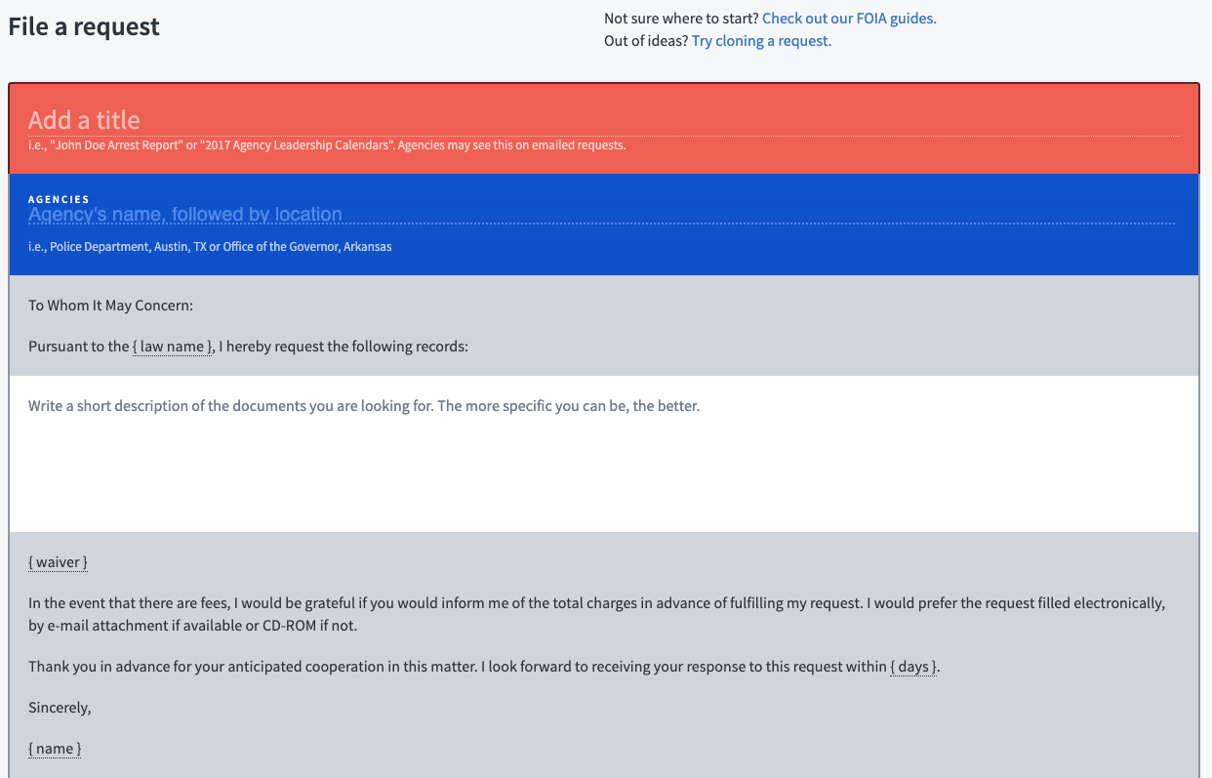
Filing a Request
GETTING STARTED
A
If the agency doesn’t exist, a New Agency task is created for the Support Team to review.
Task
B
*
Name the request
Add/create agency or agencies
Enter request text
C

Slide 5
Request Submission Methods
FILING A REQUEST
Portal
Email
Fax
Snail Mail
Task
Task
Portal or webform submissions create a Portal task to alert staff that the request needs to be manually submitted through the portal
Email submissions do not require staff assistance unless the email bounces or runs into another technical error. If this happens, the message is sent through snail mail while staff investigate.
Fax submissions do not require staff assistance unless the fax runs into a technical error. Like email, the message is sent through snail mail if this happens.
A Snail Mail task is created when the address is not Lob compliant - usually this means it either needs a mailing address or the address we already have is too long. This task requires staff attention.

Slide 6
Agency Response Types
FOLLOWING UP ON REQUEST
Portal
Email
Snail Mail
MR Link
Task
Agency replies submitted via their portal create a Portal task to alert staff that the message needs to be attached to the request. Agencies may also sometimes use “secure link” services. These messages are password-protected and expire within a few days, meaning quick staff action is important to retrieve and preserve the message.
Agency replies via email do not require staff assistance unless the email errors - with agency emails, it may show up as an Orphan task or not show up at all, requiring advanced troubleshooting or a phone call with an agency representative.
Agency responses via Snail Mail are scanned by our mailroom admin and uploaded to the request page.
Agency replies via MR Link do not require staff assistance.

Slide 7
Receiving Responsive Documents
COMPLETING A REQUEST
Portal
Email
Snail Mail
MR Link
Task
Agency replies submitted via portal create a Portal task to alert staff that the message and docs need to be attached to the request. Agencies may also use OneDrive, Google Drive, Dropbox, or secure links to provide responsive document uploads. These are password protected and may have an expiration date.
Agency replies via email do not require staff assistance unless the email errors
Agency responses and documents are sent via Snail Mail are scanned by our mailroom admin and uploaded to the request
If an agency runs into issues uploading files via MuckRock, they can write in to our support helpdesk at info@muckrock.com, or coordinate another response type with the user. Otherwise, agency replies via MR link do not require staff assistance.

Slide 8
Issues with Receiving Responses
FOLLOWING UP ON REQUEST
Portal
Email
Snail Mail
MR Link
Secure Link
Login issues
Expired account
New portal
Missing emails
Email errors
Missing mail
Agency unable to use link
Large file uploads
Expired link
Non-functioning passwords

Slide 9
Other Issues with Responses
FOLLOWING UP ON REQUEST
Ticket
Non-responsive agency
Ticket
In-state citizenship verification
Ticket
Agency refusing MuckRock requests OR rerouting the request
Ticket
Communication ended up on the request inappropriately
Ticket
Agency is asking the requester to fill out a form OR requesting additional information
Ticket
Missing communication from the agency

Slide 10


Request is Completed
REQUEST COMPLETED
No staff action needed
Requester may appeal:
Agency decision to reject
Types of documents provided
Documents missing
Lack of response/no acknowledgement
Redactions

