Slide 1

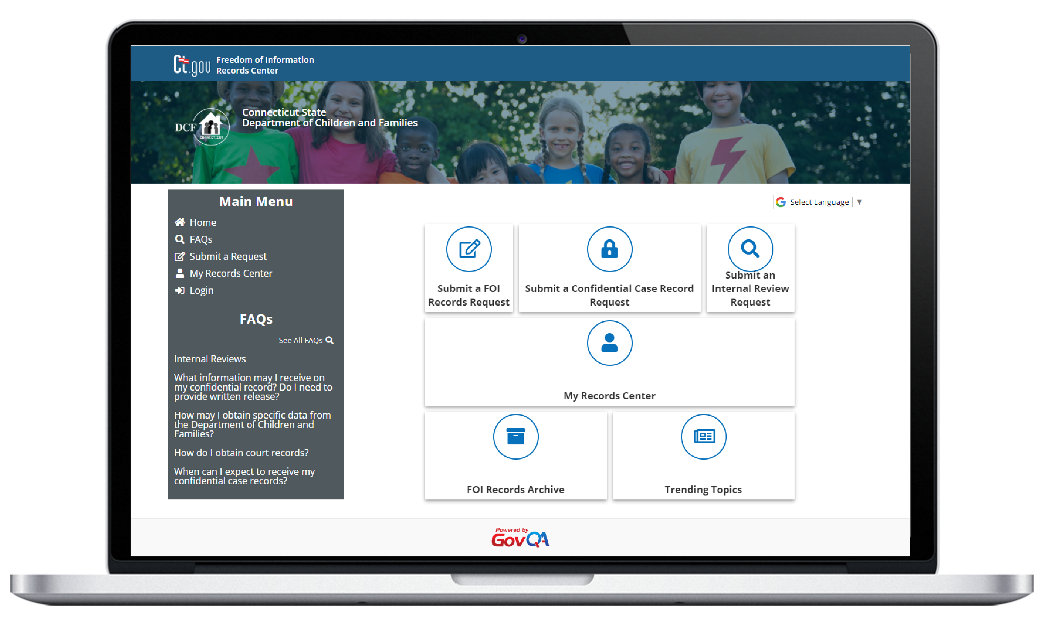
Records Request Management (RRM)
Purpose-built FOIA case management for government agencies

Slide 2
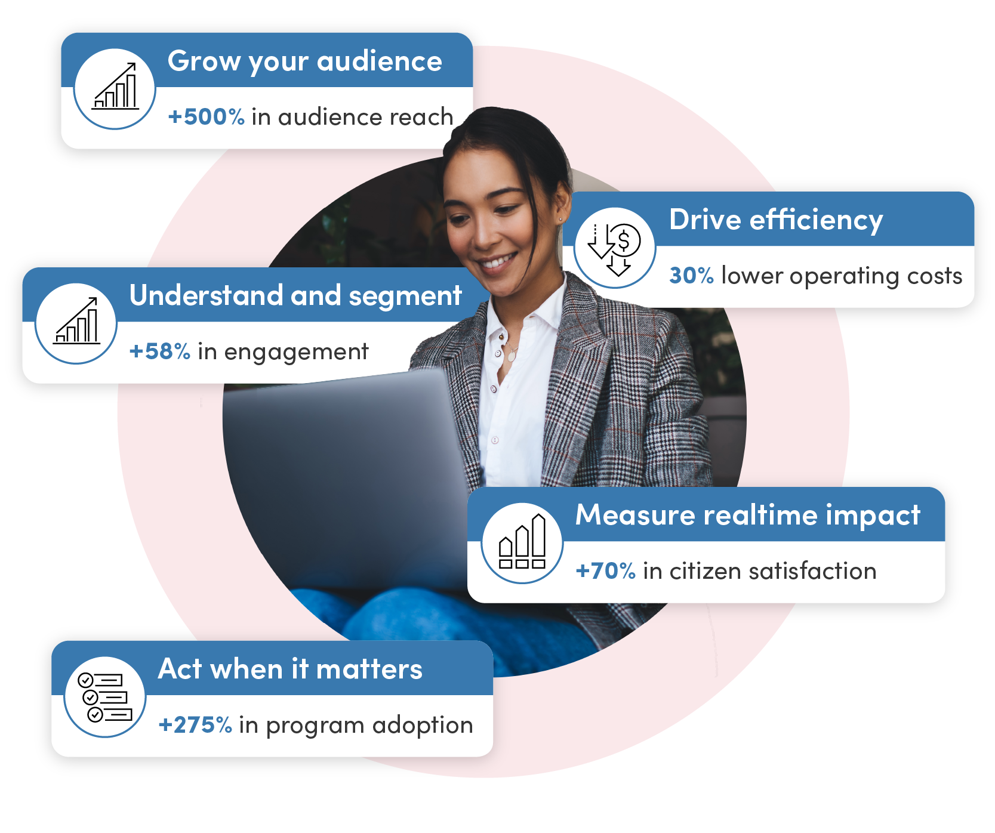
The Leader in Government Experience Solutions
Transforming how people interact with government through seamless digital experiences,
making public services more accessible, faster, and easier to use
CONNECTED TECHNOLOGY
Integrated, AI-powered government experience tech platform
500%
DATA-DRIVEN INSIGHTS
30%
Sentiment, feedback & gap analysis supported by benchmarks
Detailed customer journey analytics to uncover improvement opportunities
+58%
+70%
EXPERIENCE SERVICES
Experts providing best practice guidance
Experience Partner focused on overall program outcomes
+275%
7,000+
Customers worldwide
30 BILLION
Digital government interactions annually
360 MILLION
People in the Granicus subscriber network

Slide 3
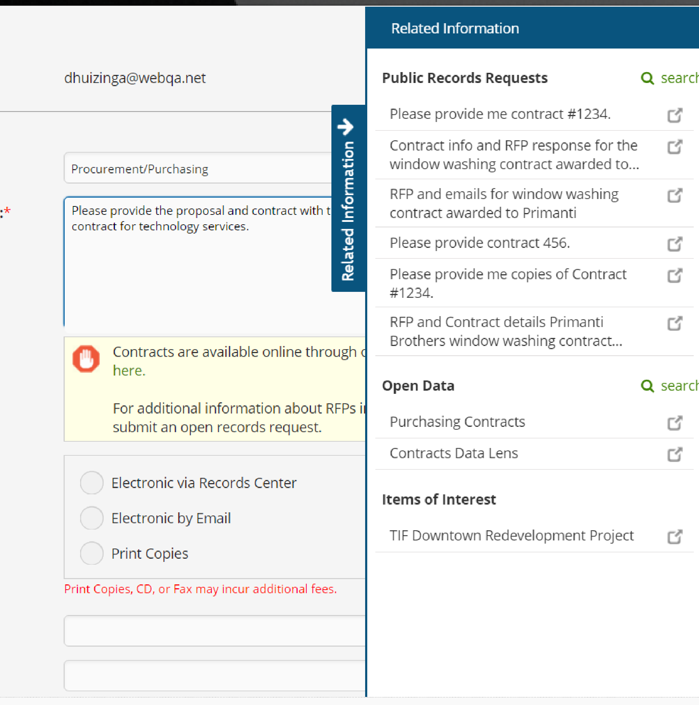
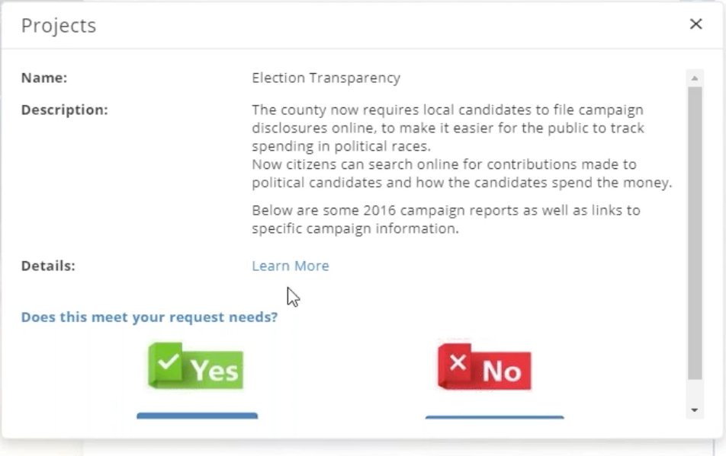
Requester Experience
What a better requester experience looks like
CLEAR, GUIDED REQEUST SUBMISSION
Structured intake that helps requesters submit complete requests without limiting scope
REAL-TIME VISIBILITY AND COMMUNICATION
Status tracking, updates, and secure messaging tied directly to the request
PROACTIVE DISCLOSURE BY DEFAULT
Prior releases and reading‑room content surfaced before submission to reduce unnecessary requests
Designed to reduce friction for requesters while preserving the full right to request records
Patented Deflection can reduce request volume by 15-20%!

Slide 4
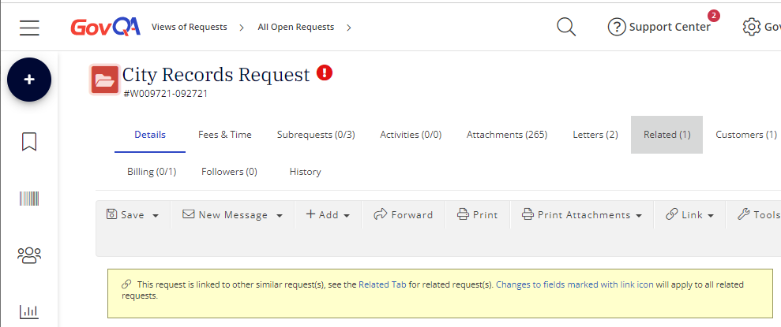
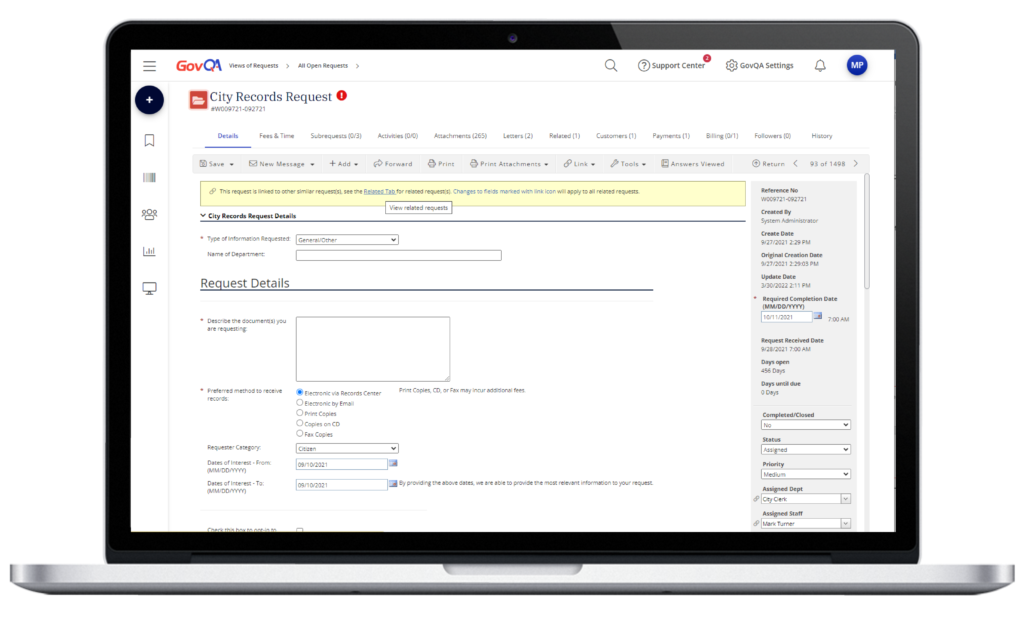
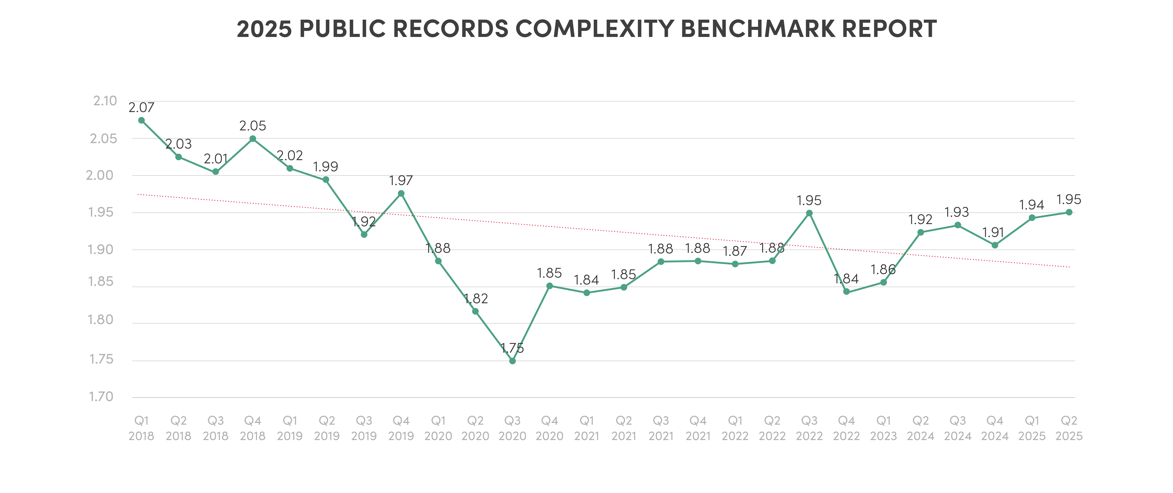
Agency Experience
Supporting agencies without undermining transparency
END-TO-END CASE ACCOUNTABILITY
Every action tracked across intake, review, redaction, communication, and release
WORKFLOW THAT MIRRORS REAL FOIA OPERATIONS
Component‑level routing, statutory deadline tracking, multiple request types
CONSISTENCY ACROSS TEAMS AND OFFICES
Standardized processes without forcing one‑size‑fits‑all operations
HUMAN-CENTERED AUTOMATION
Automation for repetitive work; disclosure decisions stay with FOIA professionals
64%
User Interactions
User Interactions
Built for defensibility, appeals, audits, and litigation – not just throughput

Slide 5
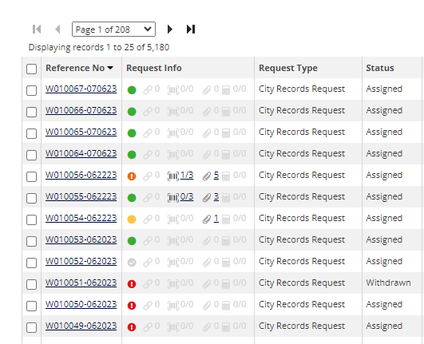
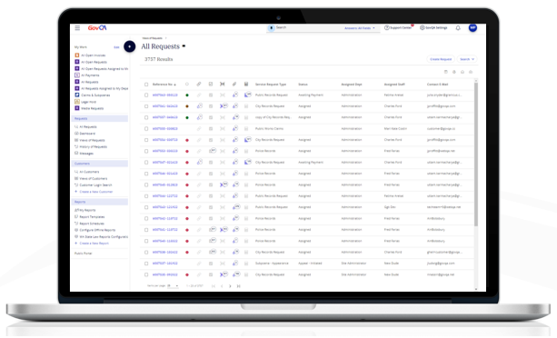
Why Granicus?
Federal market readiness underway now
PROVEN AT ENTERPRISE SCALE TODAY
Operating in complex, high‑volume government records environments
DESIGNED FOR TRANSPARENCY OUTCOMES
Public‑facing portals, auditability, proactive disclosure baked into the system
FEDERAL READINESS UNDERWAY
Actively pursuing FedRAMP authorization for Records Request Management
BUILT WITH PRACTITIONER INPUT
Inviting agencies to shape federal‑ready tooling alongside us
22+
Full-time implementation specialists
20
Years of 100% government focus
900+
Accounts in all 50 states
99%
Customer retention
User Interactions
30%
Using GovQA for 10+ years
20M
Record requests served

Slide 6
THANK YOU

