Slide 1
Promoting Justice by Illuminating Truth
Sunshine Fest
March 16, 2026

Slide 2
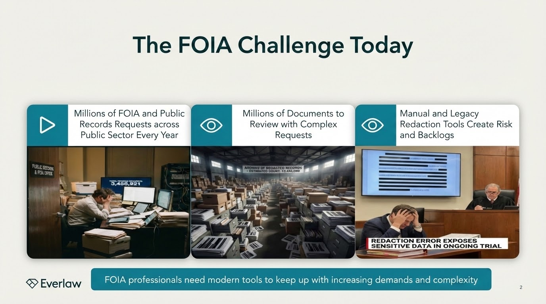

Slide 3

Everlaw Vision
The need for better legal technology
Solving hard technical problems — big data, data ingestion, AI, real-time collaboration, platform building — is what Everlaw is built to do. Our vision is to build a unified platform so that litigation and investigation teams can do all the work they actually
want to do.
AJ Shankar, Everlaw CEO & Founder
Notes:
Key points:
AJ started Everlaw nearly 15 years ago because he was passionate about solving the technical challenges that legal professionals face
He believed that the legal profession deserves better technology to solve some of those challenges; challenges that have only gotten steeper
In fact, we’ve reached a remarkable intersection of challenges, some about data and some about how work is done.
That’s why Everlaw is focused on building better technology — one, unified legal solution that legal teams can easily use, leaving the technical challenges to us and allowing legal teams to focus on the work they actually want to do.
Engagement question:
Transition:
So when you bring that vision to life, you have Everlaw.

Slide 4
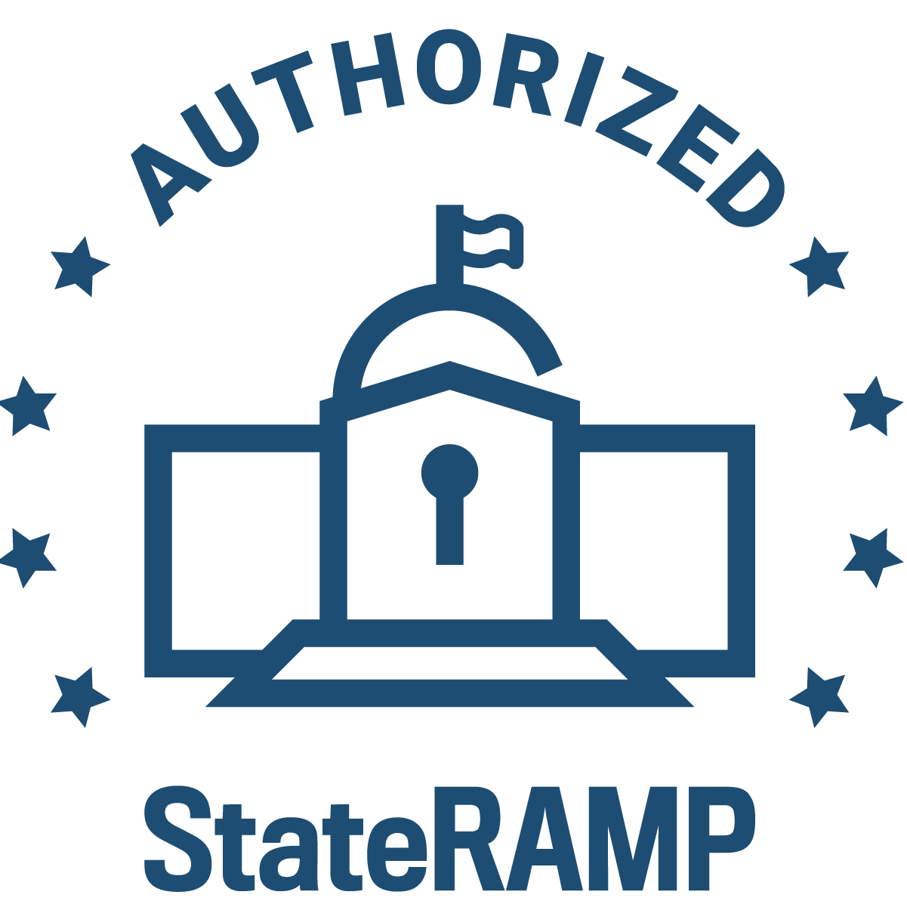




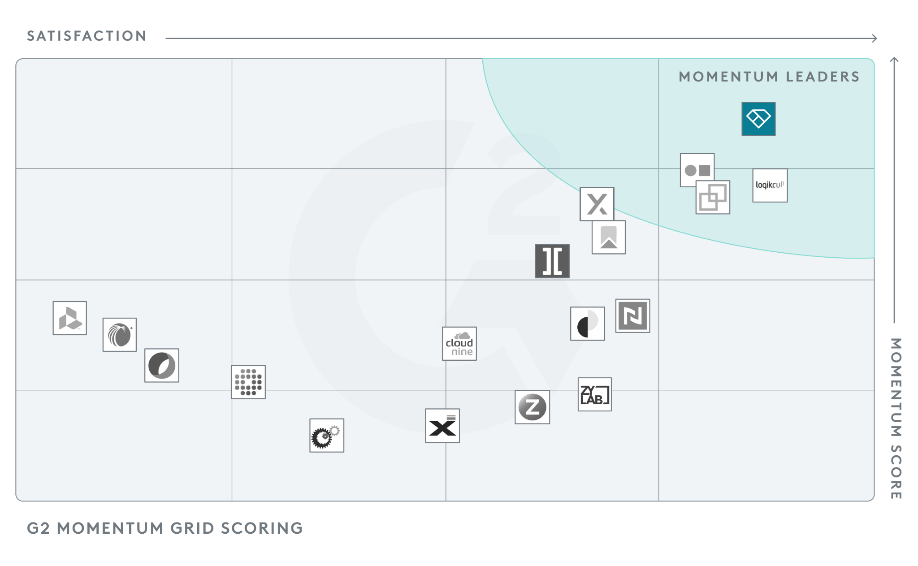



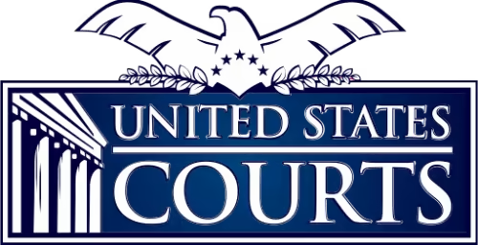

~$200M in
Series D Funding
SETTING THE BAR IN CLOUD SECURITY
Updates to the system have allowed OGC to issue and track litigation holds … and is essentially additional benefit at zero additional cost. Contractor support went above and beyond…. Without this exceptional performance, OGC would have spent multiples of additional time to produce the documents.
CPARS “Exceptional” Quality Rating
StateRAMP and
FedRAMP Authorized
RECOGNIZED BY ANALYSTS AND CUSTOMERS
#1 Overall on the G2 Ediscovery Grid®, Winter 2026 – and #1 in Usability, Relationship, and Results Indexes.
Everlaw has enabled our case teams to collaborate more efficiently. We use Storybuilder as our playground to test multiple or novel theories early on in the case, follow logical inferences to refine the theory all in real time, saving us time and effort from bringing a case that is not defensible.
Justin Hazlett, Section Chief of Consumer Litigation, Indiana Attorney General’s Office
100% of U.S. State
Attorneys General use Everlaw

Slide 5
Everlaw was built by U.S. persons on U.S. soil in direct response to U.S. government input and requirements.
Unpredictable/hidden/add-on costs
Unmet promises of efficiency due to solution slowness, missing features, and difficulty to learn
Need for multiple solutions
to get the job done
Employee dissatisfaction with
old solutions
Need for best-in-class security and all-in-one solution
Need to be entirely U.S. developed and deployed with all U.S. personnel
Notes:
VALUE MESSAGING GUIDE
Key points:
Unfortunately, the pain points that have long been associated with ediscovery can still persist with cloud solutions.
These are pain points like unpredictable costs, unmet promises of efficiency, the need for multiple solutions to get the job done, or employee dissatisfaction with the solutions available to them.
These aren’t just minor inconveniences; these pain points have serious impacts, making it hard to keep costs in check, take on more matters and larger matters and grow firm revenue, retain and hire employees, and retain and acquire new clients.
Engagement question: How do these align with what you’re seeing today? (Follow-up question: What’s the impact of that?)
Transition: We’ve not only developed Everlaw to address these kinds of challenges and the impacts they have on the workings of government agencies, but it’s why government agencies from coast to coast at the federal, state and local levels, continue to choose Everlaw
—
Example talk track:
Unfortunately, the pain points that have long been associated with ediscovery can still persist with cloud solutions.
These are pain points like
Unpredictable or uncontrollable costs, due to add-on fees or charges for what should be basic tasks, like getting your data in/out of your solution and getting your technical questions answered;
Unmet promises of efficiency due to solution slowness, missing features that require work outside of the platform or purchasing add-on solutions, and time spent trying to learn hard-to-navigate tech;
The need for multiple solutions to get the job done (which might look like having separate solutions for processing, review, post-review and trickier file types like videos or audio files) – Everlaw’s capabilities can replace up to 7 disconnected solutions with just 1; or
Employee dissatisfaction with the solutions available to them, impacting employee morale and efficiency.
The need for top-notch, in-depth security, in line with gold standard government guidelines like FedRAMP and StateRAMP, as well as a firm commitment to being entirely developed and deployed on U.S. soil, by U.S.-based personnel, only.
And these aren’t just minor inconveniences; these pain points have serious impacts, making it hard to keep costs in check, take on more matters and larger matters and scale government operations, retain and hire employees, and fulfill mission-critical projects on time, securely.
How do these align with what you’re seeing today? (Follow-up question: What’s the impact of that?)
Transition: We’ve not only developed Everlaw to address these kinds of challenges and the impacts they have on the efficiency of government review teams, but it’s why government agencies end up choosing Everlaw to achieve all sorts of key outcomes…

Slide 6
Easy to Use, Fast and AI Powered FOIA Workflows
FedRAMP Authorized AI‑Assisted Prioritization of Responsive/Sensitive records
Predictive Coding to rank large collections by likely responsiveness, so FOIA staff review the most important records first
Coding Suggestions to propose FOIA codes (e.g., responsiveness, exemption categories) with rationales, speeding first‑pass review and QC of prior work
Summarization, Topic and Entity Extraction for Faster Triage
Batch document summaries, topic/sentiment analysis, and people/organization extraction to quickly understand long emails, reports, and investigative files and decide what needs deeper manual review.
Concept Clustering for Broad / Ambiguous FOIA Requests
Concept Clustering groups records by meaning (not just keywords) to uncover themes and unexpected pockets of potentially responsive material when request language is broad or vague.
Custom extractions and PII-focused review
Custom field extractions (e.g., names, IDs, key dates, policy citations) across large sets; widely used for FOIA to help surface PII and other sensitive elements that drive exemption and redaction decisions.

Slide 7
Ditch the Luck, Find the Gold: See Everlaw in Action this St. Patrick’s Day
12:00 pm - 4:15 pm
B262 (Basement Level)

