Slide 1

Casepoint FOIA
The most powerful FOIA platform on the market.
Public Portal · Management App · Enterprise eDiscovery · GenAI

Slide 2
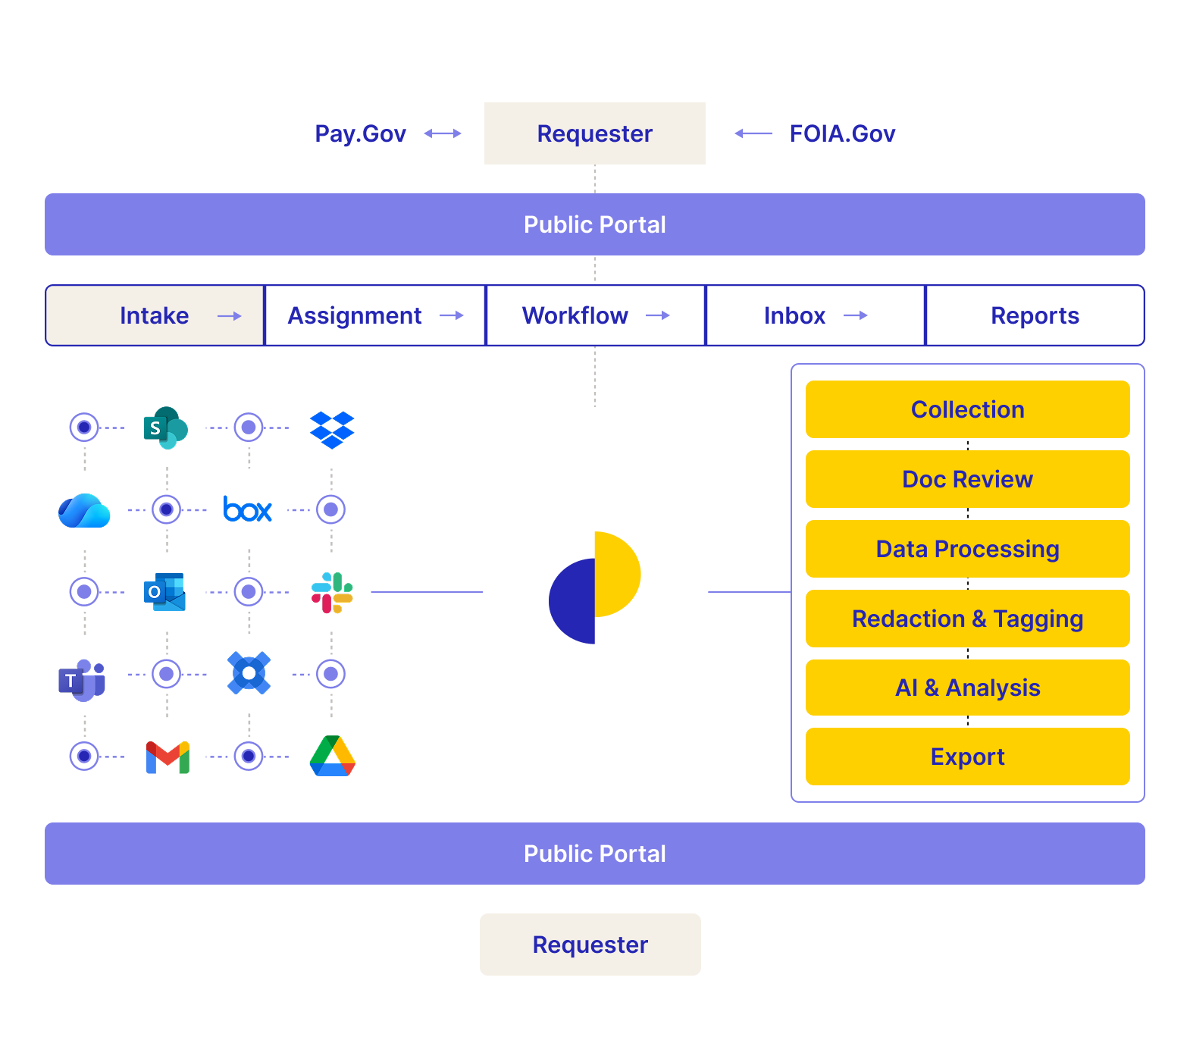
Accelerate FOIA Processing and Reduce Historic Backlogs​
CASEPOINT FOIA
Manage the entire FOIA lifecycle of requests, from initial inquiry to delivery of documents through archival of the case, on one single platform, while ensuring compliance with U.S. Department of Justice (DOJ) reporting and procedural requirement.

Slide 3


Four Powerful Tools. One Platform.
CASEPOINT PLATFORM
Public Portal
Management App
Enterprise eDiscovery
GenAI
Branded, customizable FOIA intake portal accessible from any device. Includes a Reading Room to proactively publish documents and reduce incoming request volume.
Full FOIA request lifecycle tracking — assignment, due dates, correspondence, task automation, and deep configurability to match your agency's workflow.
600+ file types, native redactions, bulk redaction templates, video face detection, and powerful keyword/metadata/phonetic search. The same engine used by top federal agencies.
Five native AI capabilities: chat-based search, document summarization, document categorization, AI Reading Room search, and a FOIA Writing Assistant.

Slide 4




Where Every FOIA Request Begins
01 — PUBLIC PORTAL
Your Brand, Your Rules
Reading Room
Smart Request Form
Instant Confirmation
Fully customizable portal: your logo, colors, and fields. No IT required. Live on day one.
Proactively publish frequently-requested documents. Reduce incoming FOIA volume before it starts.
Fields adapt by Component and Request Type. Members of the public submit in under two minutes.
Automated confirmation email sent immediately on submission. Customizable by your FOIA admins.

Slide 5
Your FOIA Operation, Fully in Control
02 — MANAGEMENT APP
Instant Intake
Bulk Assignment
Requests from the portal land directly in the app — no manual entry, no delay.
Assign to individuals or entire teams. Automated notifications on assignment.
Correspondence Log
Deep Configurability
Full audit trail of every automated and manual email sent on a request.
Email copy, form fields, tracking numbers, redaction codes — all yours to configure.

Slide 6
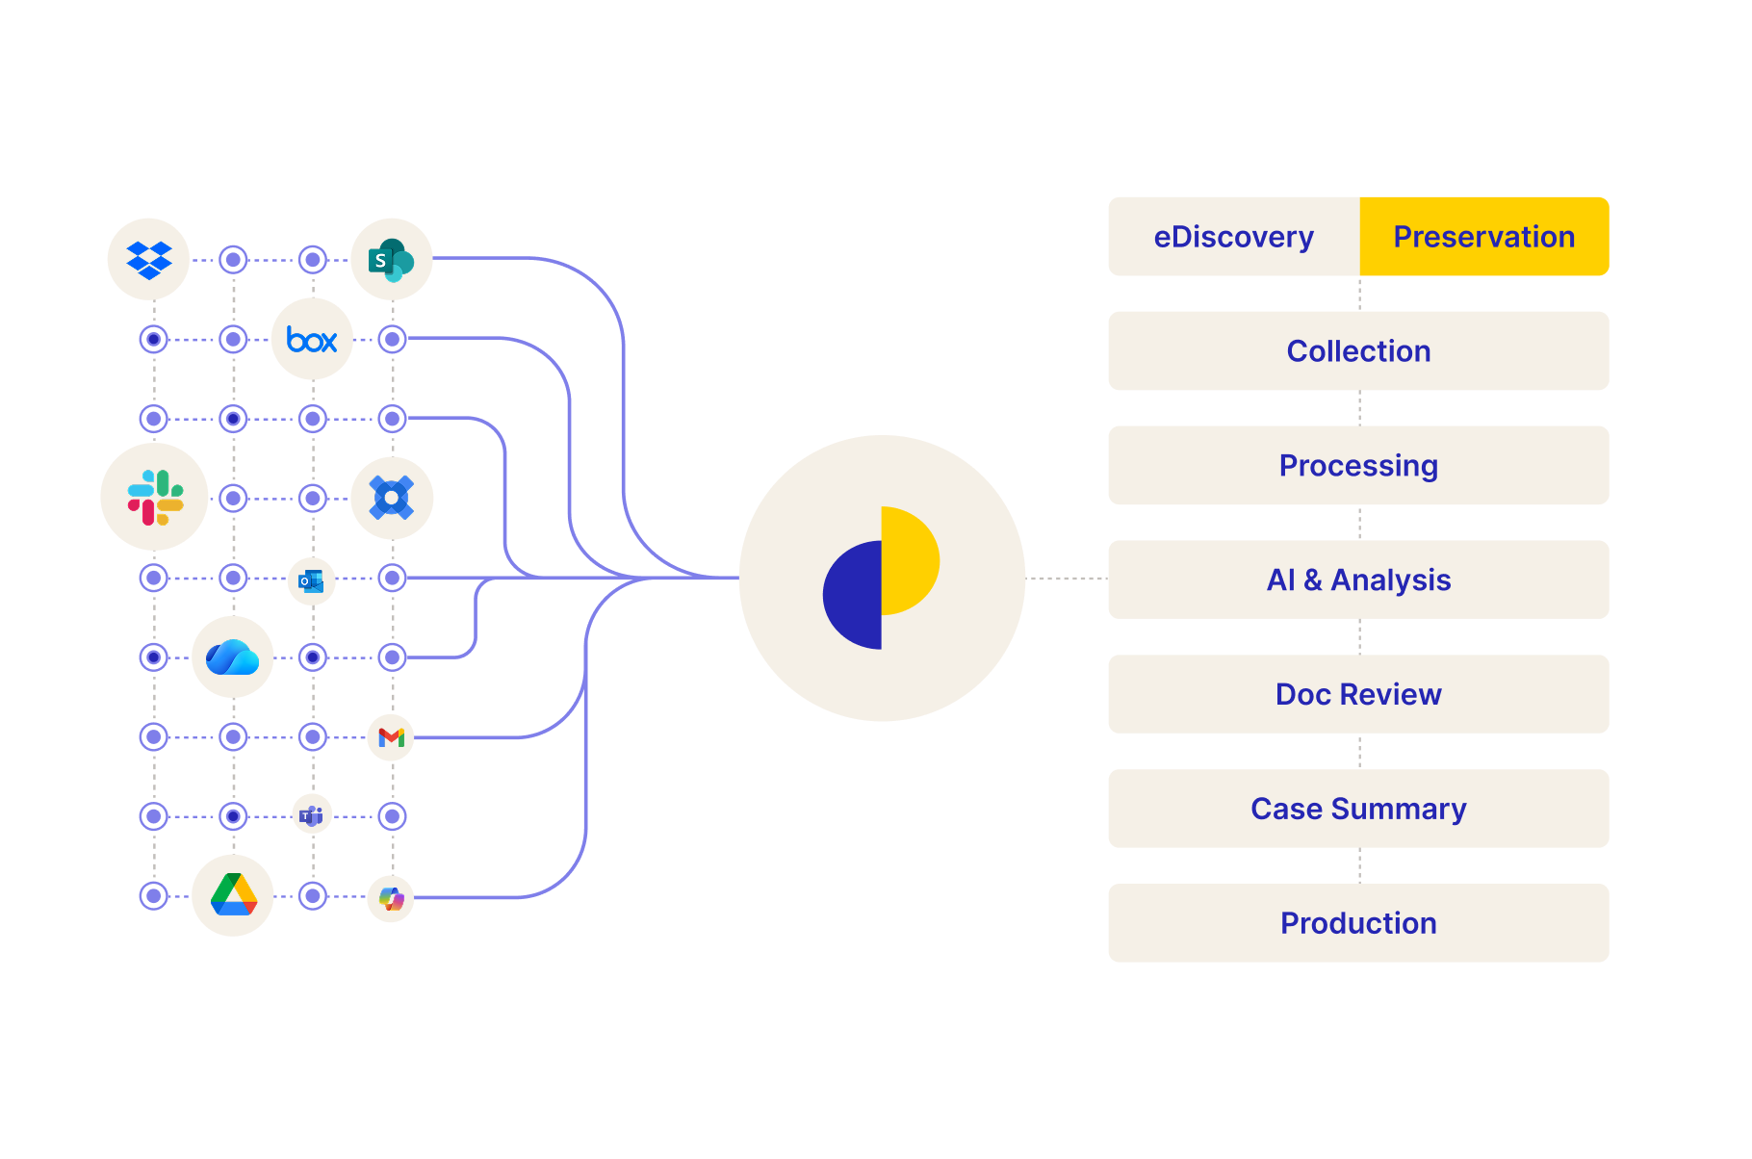



Smarter eDiscovery. Better Decisions.
03 — ENTERPRISE EDISCOVERY
One platform to manage preservation, collections, processing, analytics, review, and production without fracturing your audit trails.​
600+ File Types
PDFs, Excel, video, email — all rendered natively in-browser. Never download a file just to review it.
Powerful Search
Keyword, metadata, Boolean, synonym expansion, phonetic matching. If it's in the system, you'll find it.
Bulk Redaction Engine
Redact SSNs, emails, phone numbers, and custom terms across thousands of documents in one pass.

Slide 7
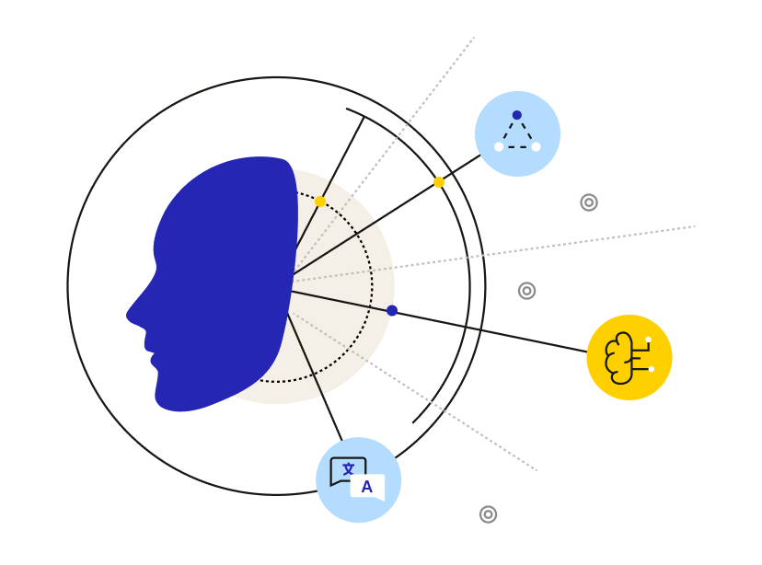
Five Native AI Capabilities. Do More. Review Less
01
Chat-Based Search
Plain-English questions. No Boolean syntax. The system understands intent — faster for experts, accessible for everyone.
04 — GENAI
02
Document Summarization
Instant AI summaries — key points, dates, notable content. Turn a 30-minute review into 3 minutes. Hours saved per week.
03
Document Categorization
AI automatically classifies documents as they're reviewed. Less sorting. Right place from the start.
04
AI Reading Room Assistant
The public searches your published documents in plain language. They find it — and never submit a request.
05
FOIA Writing Assistant
Helps requesters draft or refine clear, FOIA-ready requests. Encourages specificity and completeness up front. Reduces back-and-forth clarification for agencies.

Slide 8
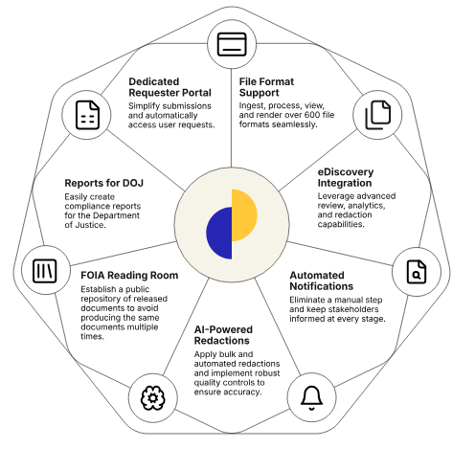
One Platform. Zero Compromises.
CASEPOINT PLATFORM
Simplify the management and fulfillment of FOIA (Freedom of Information Act) requests. Create a customizable workflow using our technology to develop a solution for your unique FOIA needs.
Organize and track requests in the same centralized platform hosting your documents.
Perform targeted searches to identify documents and prepare FOIA responses quickly.
Design your own reports that bring all of the critical information together and make reporting to the Department of Justice stress-free.

Slide 9
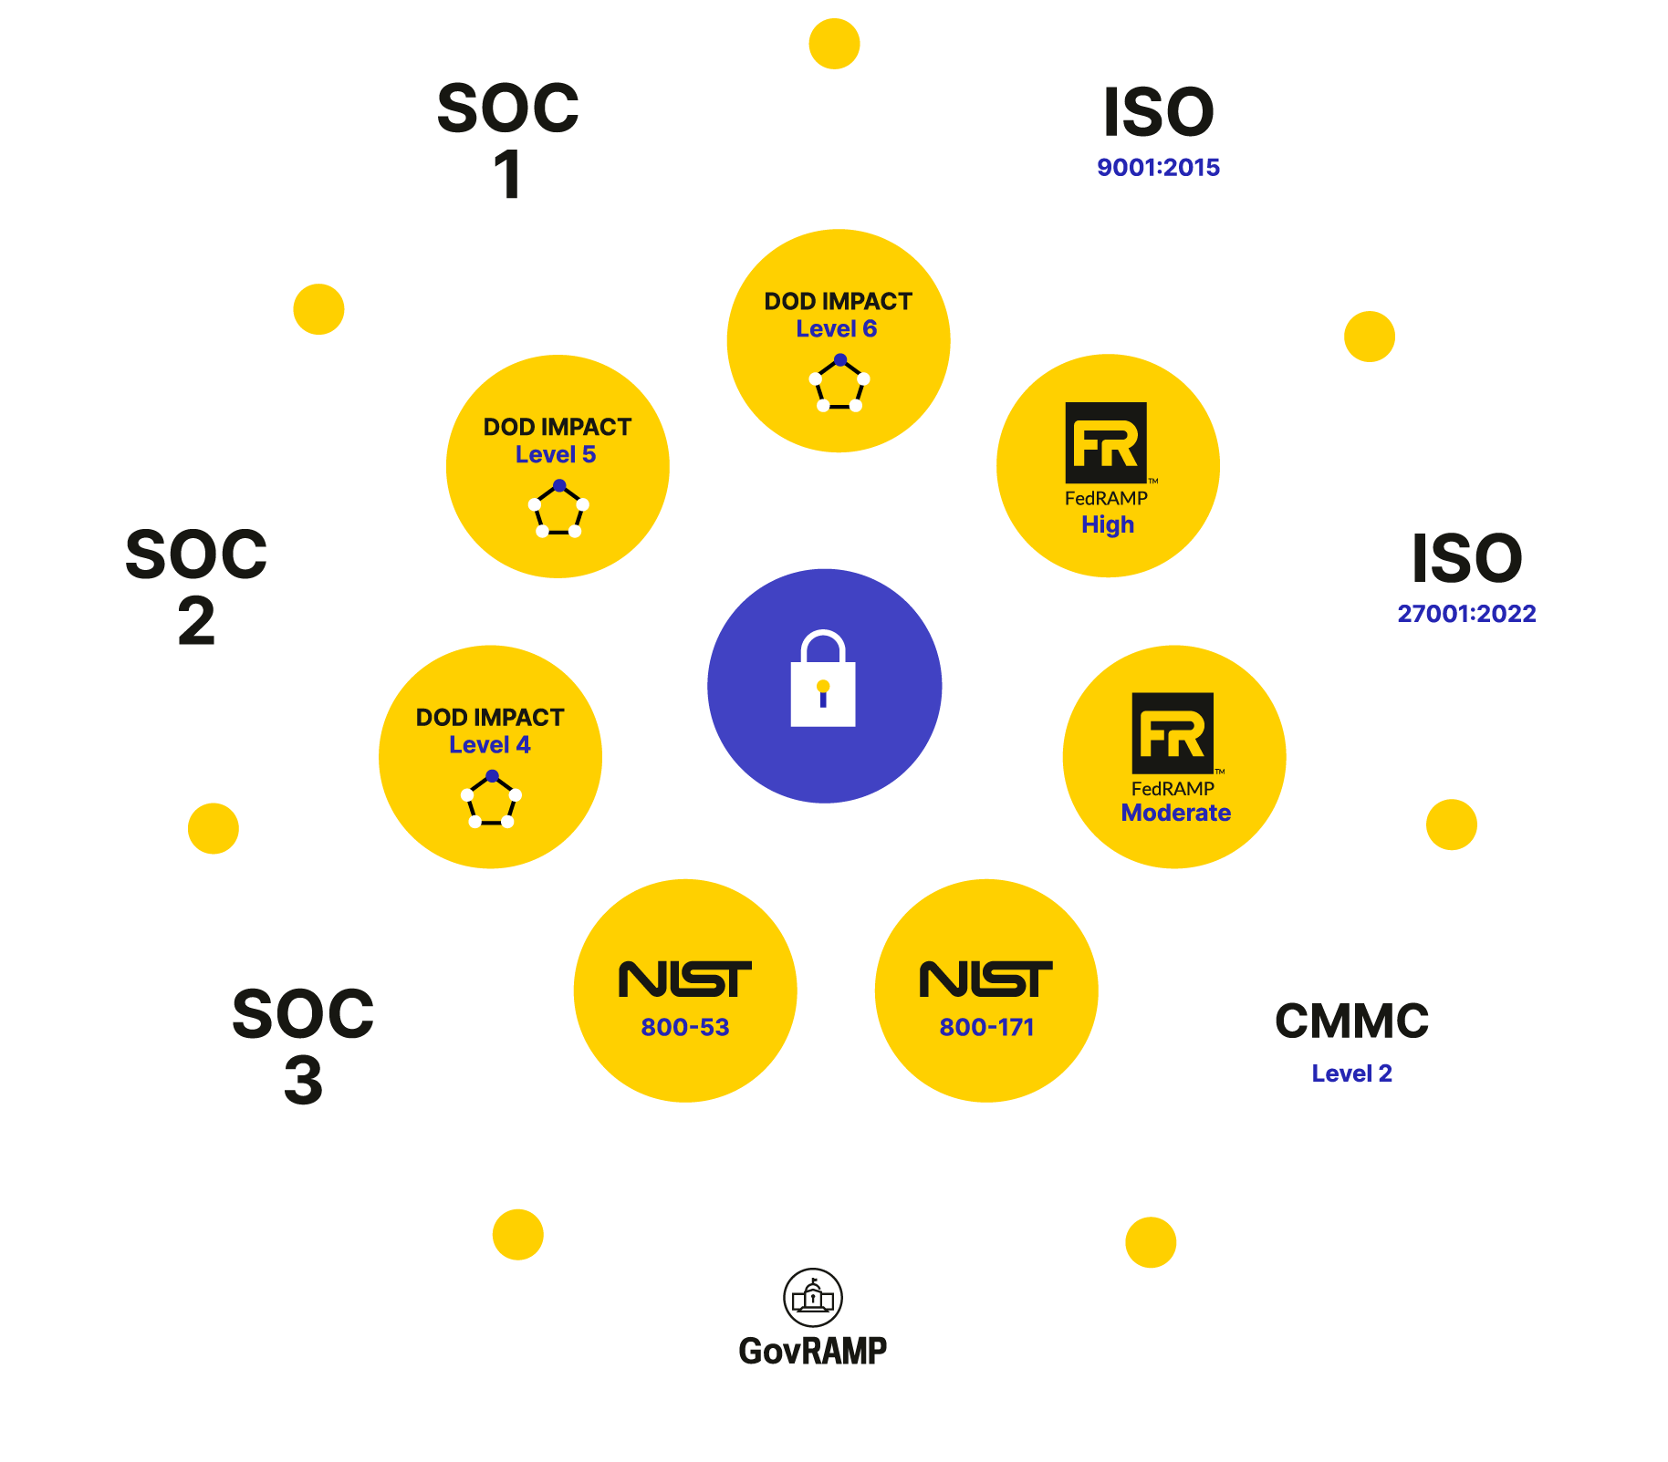
Superior Security. Trusted Protection.
9

Slide 10
Ready to See It Live?
Casepoint FOIA sets a new standard for federal agencies, offering a configurable, all-in-one system that transforms FOIA workflows.
Join the ranks and experience unmatched efficiency in FOIA management.
Public Portal · Management App · Enterprise eDiscovery · GenAI

