Slide 1

We make it easy to find bills and regulations.
We strive to make our democracy more democratic by helping everyone understand and participate in the legislative process.

Slide 2

What We Do
We make complicated legislative information as accessible as possible:
Search results from Congress and all states are presented in an easy-to-understand grid that includes links to more detailed information
Our bill pages include plain English AI-generated summaries, available to everyone
We present bills in the same format across all states
We also provide full contact details for all current legislators to encourage citizens to get involved

Slide 3
Services
Free Subscription allows citizens to search by keyword or bill number to discover and review an unlimited number of state and federal bills
Share bills
Search legislators currently in office
Search current committees
Utilize AI research tools
Paid Subscription
Unlimited users
Access historical data
Create unlimited bill sheets, regulation sheets, and custom daily alerts

Slide 4
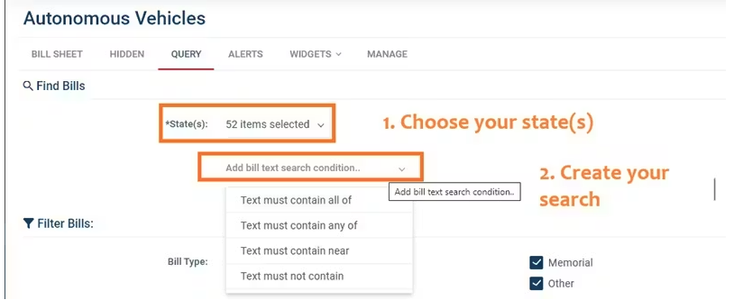
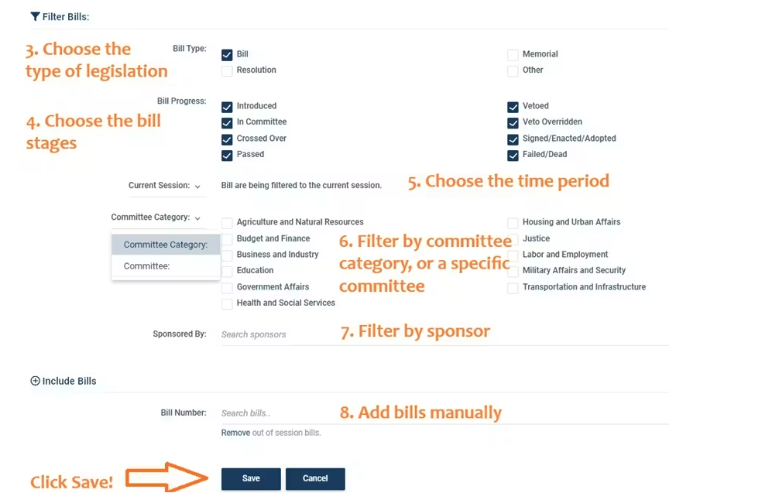
Bill Sheet
Create the criteria for your bill sheet

Slide 5
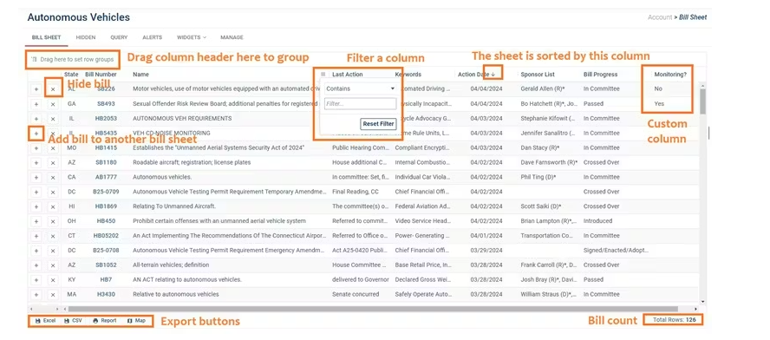
Manage Bill Sheet

Slide 6
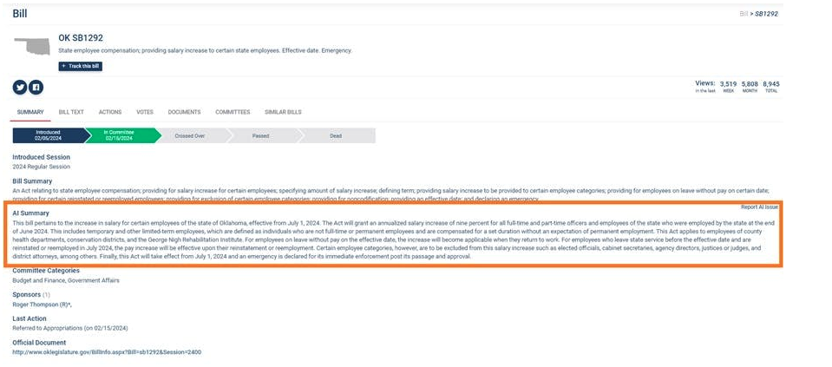
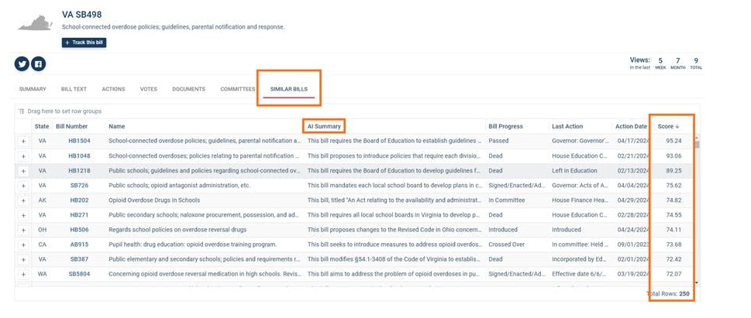
BillTrack50 AI Features
AI Generated Bill Summaries
Discover Similar Bills using AI

Slide 7
Contact Us
Karen Suhaka (Founder) – Karen@LegiNation.com
Kendra Longworth (Research Analyst) – Kendra@LegiNation.com
Website – billtrack50.com
General Inquiries – BillTrack50Info@legination.com

