Slide 1



MASTERING FOIA WITH
A Modern Approach to FOIA Management
PRESENTED BY
RAY AZARM
VP of Enterprise Practice
Armedia

Slide 2





REIMAGINING FOIA – A NEW ERA OF TRANSFORMATION
FOIA Challenges Are Real
Requests
Complexity
Litigation
Resources
Our Vision
Technology as a force multiplier
Automation that accelerates review
Systems that prevent problems instead of reacting to them

Slide 3


INTRODUCING ARKCASE
THE FOIA AUTOMATION SOLUTION
Automate FOIA workflows Reduce manual work with AI-assisted classification, redaction, and processing.
One unified platform Manage requests, records, documents, multimedia, and correspondence in a single system.
Faster responses & better transparency Powerful reporting and analytics improve visibility and performance.
Improve requester experience Modern portals and streamlined processing reduce delays.
FedRAMP-authorized security Built for federal agencies with enterprise-grade compliance and protection.

Slide 4


MEET ARKCASE ILLUME
The Intelligent Automation Layer
Key Capabilities
Exemption-driven redaction Identify sensitive content and accelerate exemption review.
Smart prioritization and categorization Surface high-risk, complex, or time-sensitive requests first.
Conversational AI assistance Ask questions about cases, documents, or FOIA activity and get instant answers.
Modern public portal Help requesters search reading room; help agencies obviate requests!
What ArkCase Illume Represents:
Insightful
Clarifies complex information and workflows
Signals innovation and workflow modernization
Modern
Analytical
Represents data-driven decision making
Trustworthy
Feels professional, helpful and GovTech-appropriate

Slide 5

DOCUMENT REVIEW
SUPER AUTOMATING THE PROCESS
Document Review:
Rapid document discovery Quickly surface responsive records across large datasets.
AI-assisted exemption detection Identify potential FOIA exemptions and sensitive content earlier in the review process.
Collaborative review workflows Coordinate reviewers across offices and agencies.
Prioritization of complex requests Focus attention on the most sensitive or time-critical requests first.
Value: Accelerates response times, improves accuracy, and ensures compliance, leading to more efficient FOIA request processing.

Slide 6



ANALYTICS: PLANNING FOR THE FUTURE
Predictive Intelligence: Staying Ahead of the Curve
Proactive Disclosure: Rule of 3
Anticipating Request Trends: Forecasts incoming volumes.
Identify Bottlenecks: Fix issues before they become problems.
Monitor compliance and deadlines: Track response times and reduce the risk of missed statutory timelines.
Automated Priority Sorting: Ensures high-priority requests get attention.
Value: Enhances efficiency by proactively managing workloads, ensuring high-priority requests are addressed promptly, and reducing backlogs.

Slide 7

FOIA PORTAL:
A REIMAGINED USER EXPERIENCE
A Modern, AI-Enhanced FOIA Portal
Simple and perfect request submission
AI-assisted guidance with chatbot
Reading Room with Smart Search
Automate Document Summaries
Request tracking
Obviate requests and report on it
End-to-end Section 508 accessibility across the FOIA portal, ArkCase application, and released responses
Value: Increases transparency, improves user experience, accelerates access to relevant information, and potentially reducing the number of requests

Slide 8

CHATBOTS
ENHANCING USER EXPERIENCE AND EFFICIENCY
AI Chatbots: The 24/7 FOIA Assistant
Instant Request Handling: Guides users through the request process.
Automated Status Updates: Provides real-time status updates.
Natural Language Understanding: Offers accurate, instant information.
Feedback Collection: Gather user feedback to continuously improve the FOIA experience and identify areas of concern.
Value: Enhances user experience by providing instant support, real-time updates, and valuable
insights, while reducing the workload on FOIA officers.

Slide 9
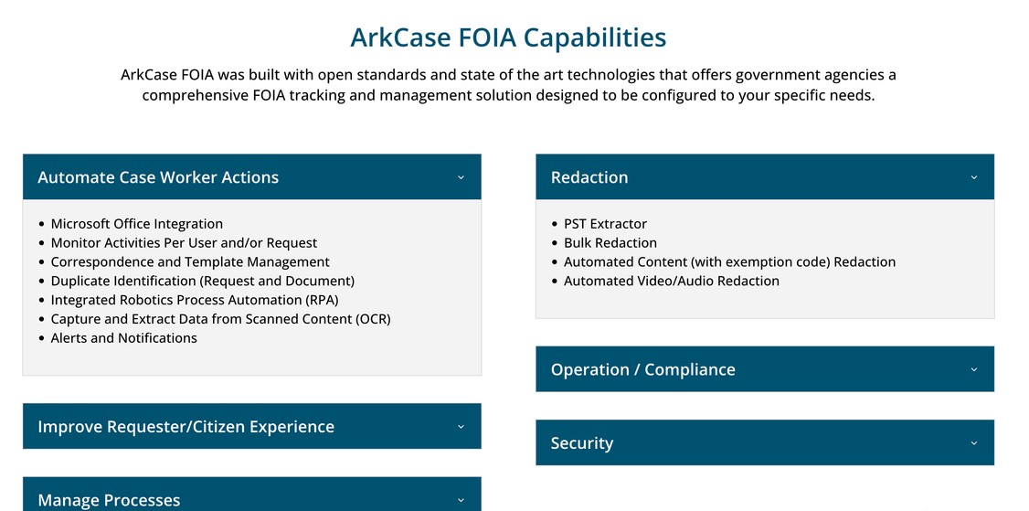
LOOKING AHEAD
THE FUTURE OF FOIA IS NOW
Our Vision for a Reimagined FOIA Landscape
Autonomous Case Management: AI handling repetitive tasks, freeing you for complex decision-making.
Collaborative AI and Human Teams: Humans and AI working together seamlessly, delivering unparalleled efficiency.
Interoperability between FOIA solutions: Improved collaboration, transparency, time savings, etc.

Slide 10



JOIN US IN REIMAGINING FOIA
Embrace the Future with ArkCase
REIMAGINING FOIA
Faster responses
Greater transparency
Smarter government
www.arkcase.com
www.armedia.com

